Slide 1
Enriching life through communication
Huawei in Uzbekistan
Notes:
Dear Ladies and Gentlemen,
Today I would like to make brief introduction about Huawei company in the world and draw your attention to development and operation in the territory of Uzbekistan.

Slide 2

Huawei at a glance
A leading E2E ICT solution provider
Become important player in Enterprise and Consumer markets
150,000+ employees with 150 nationalities worldwide, 46% dedicated to R&D
Revenue: USD38,7 billion in 2012.
As of the end, 2010

Slide 3






































Huawei Business Update
Sustainable Growth
Serving Top Operators
Global Operations
Continuously create
long-term value for customers
Serving 45 of world's top 50 operators
1/3 of the world's population
15 sub-regions and 100+ branch offices
20 R&D centers
36 training centers
Revenue (CNY in billions/ (US$))
35.4
(CNY220.4 bln)
CAGR: 22%
32.4
(CNY203.9 bln)
27.6
(CNY182.5 bln)
21.5
(CNY146.6 bln)
HUAWEI (Headquarters)
18
(CNY123.1 bln)
12.6
(CNY 92.2 bln)
2007
2008
2009
2010
2011
2012
(Unaudited)
R&D Centers
Customer Service Centers
Huawei Technologies releases an annual report with consolidated financial statements audited by KPMG.
As of the end of December, 2012

Slide 4


Focus on Government ICT Development & Selected Industries
Government &
Public Sector:
E-Gov, Safe City
Transportation:
GSM-R
Large enterprises
Finance
ERP
CRM
CRP
Energy & Power
SMB
SDI
Cloud DC
HR
SCM
Storage/Server
UC
Wireless
OA
BYOD
eSight
Customer-centric
culture
Security
Financial
Carrier
Business
Networking
Consumer
Business
Energy
Energy

Slide 5
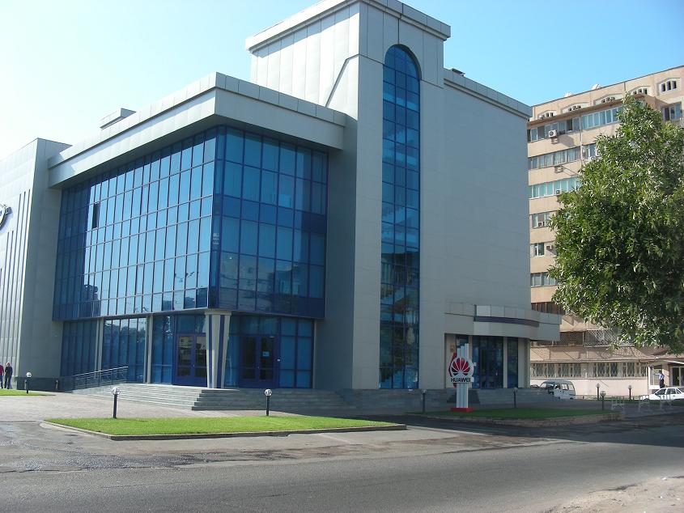
Huawei Uzbekistan update
Huawei Uzbekistan established in 1999, since 2010 Tashkent is the regional center for Central Asia & Caucasus
No.1 telecom solution provider
Best Tax payer of 2009 (praised by Uzbekistan Tax committee)
Over 200 staff in Uzbekistan, 80% local employees
Numerous engineers from Service partners
Boosting the development of Uzbekistan informationization and economy, creating more job opportunities for the whole industry value chain.
As of the end of December, 2012

Slide 6
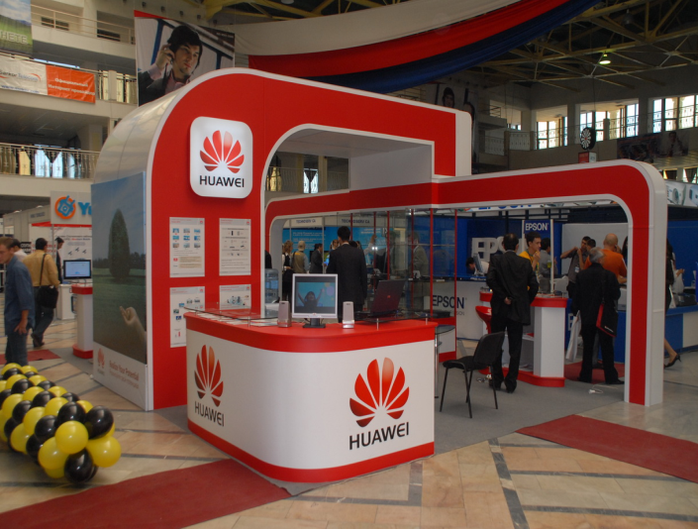
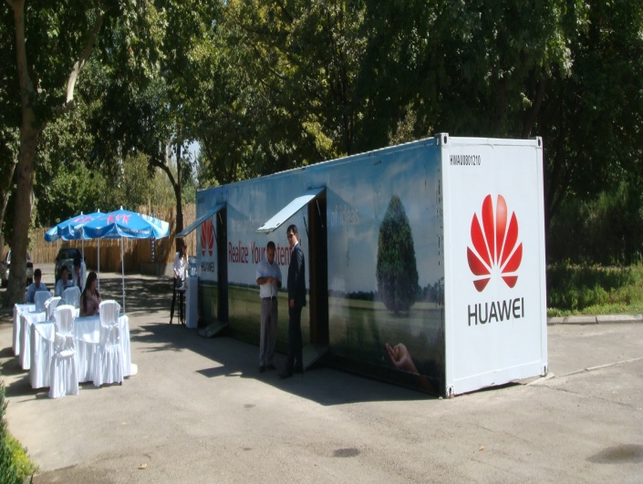
Bringing latest Tele-Technology into Uzbekistan
Established local Training center for Uzbektelecom,
2007,Realized First 3G call in CIS in 2007 together with Beeline Uz.
Built First NGN Commercial network in CIS region for East Telecom.
Constructed First Metro DWDM network in Central Asia for TCTN.
Constructed National E-Education Network for Higher Education ministry.
Built Uzbekistan Ministry of Finance Treasuries IP Network in Tashkent.

Slide 7
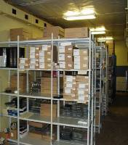

Excellence Customer Service in Uzbekistan
Spare Parts Service
Technical Assistant Center
Tashkent Distribution Center: 100M² area and > 400 categories
Moscow Distribution Center: 300M² area and >1000 categories
Next working day arrive
7*24 Call Center
7*24 Technical Assistant Center
Website support
Controlled by ISO9001 standard
Realizing customers services excellence through localization

Slide 8

As the Regional Center of Central Asia
10 countries in CA region
HQ of CA in Tashkent,Uzbekistan;
Istanbul, Turkey
    2011 Opened Bidding Projects Share Center (BSSC) in Tashkent serving for all Euroasia countries.
    2012 regional HQ Serving CA and Caucasia was moved from Istanbul to Tashkent by exploiting Uzbekistan’s advantages in human resources, geographical location, and economic policies.
Notes:
8
8

Slide 9



A Responsible Corporate Citizen
Environmental protection
Helping operators decrease OPEX and cut energy consumption and emissions through green networks;
Smart 2020 Germany-reduce CO2 emissions of the ICT industry;
Local commitment
Promote local economy through localized operations: service institutions, training centers and technical support centers etc.
best Tax payer of 2009 (praised by Uzbekistan Tax committee)
80% employees in representative offices are local recruits;
Community engagement
Sponsoring for ICT EXPO in Tashkent;
Established Annual award for talent students and teachers of TUIT, with total budget - 100M soums;
Granted Videoconference system for TUIT and its 5 branches;
Lending a helping hand to the Uzbek refugees from Kirghizia;
Sponsoring athletes of Uzbekistan at the 16 Asian Games Guangzhou;
Donating computers, Handsets and Modems to the young people.

Slide 10
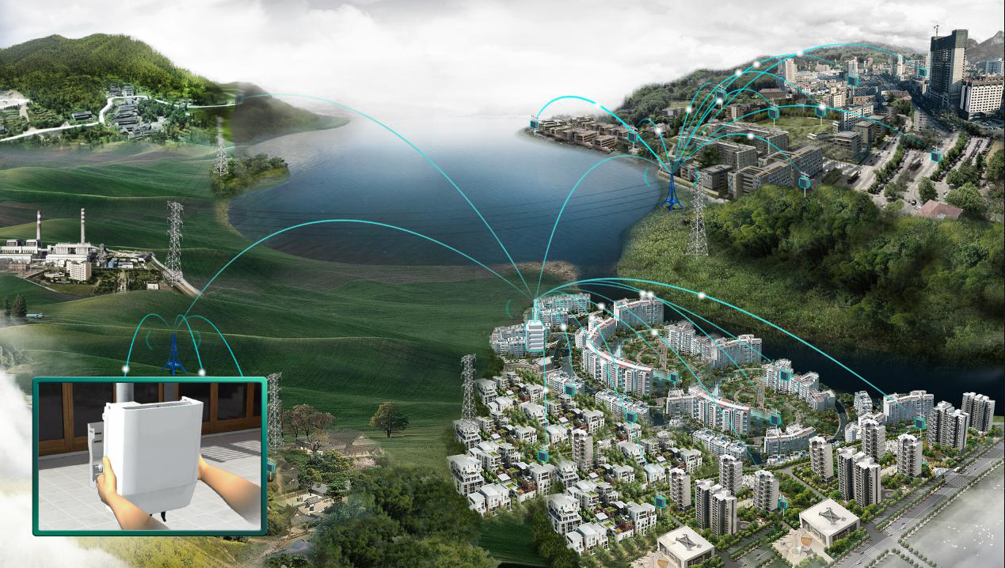

Contribution for Uzbekistan ICT Development
Upgrade up to 100 Gbps of National Backbone network based on DWDM technologies including all regional centers in the country.
Connection of 200 Colleges to National e-Education Network, which was constructed in 2012.
Countrywide expansion of CDMA 450 network with EV-DO support
Development of Fiber Optic Broadband Access network based on FTTx technologies
Notes:
中国的第一个基于LTE的配电自动化项目。
无需挖勾布线，LTE工程建设成本比敷设光纤方式要低80%。
部署灵活，建设周期比敷设光纤方式降低50%以上。
解决方案：
1.采用易部署、易扩容的LTE专网组网作为配电自动化通信解决方案
2.提供可视化运维的统一网管平台，降低运维成本及难度
3.承载网双平面、防火墙、业务数据加密等设计，端到端保障通信安全可靠。
背景及客户痛点：
老城区负荷重要，现有配电设备老化、线损高，通信技术落后。
城区改造建设要求通信网络调整、扩容方便。
终端多，运维复杂，管理成本高

Slide 11

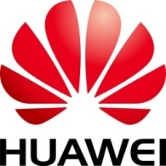
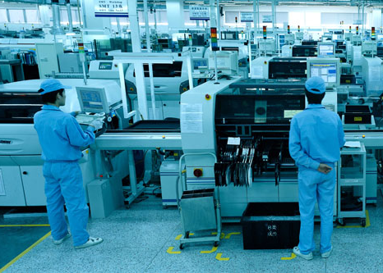
JOINT VENTURE
DJIZZAKH
SPECIAL INDUSTRIAL ZONE
JV is established for the purpose of developing the local and international market of information-telecommunication equipment and propelling the industrialization of Uzbekistan
The products of the JV will cover active equipment solutions of GPON technologies which is used in Fiber Optic Broadband Access Network.
Notes:
中国的第一个基于LTE的配电自动化项目。
无需挖勾布线，LTE工程建设成本比敷设光纤方式要低80%。
部署灵活，建设周期比敷设光纤方式降低50%以上。
解决方案：
1.采用易部署、易扩容的LTE专网组网作为配电自动化通信解决方案
2.提供可视化运维的统一网管平台，降低运维成本及难度
3.承载网双平面、防火墙、业务数据加密等设计，端到端保障通信安全可靠。
背景及客户痛点：
老城区负荷重要，现有配电设备老化、线损高，通信技术落后。
城区改造建设要求通信网络调整、扩容方便。
终端多，运维复杂，管理成本高

