Slide 2
Slovenian insurance market overview
Alexander Barsukov

Slide 3
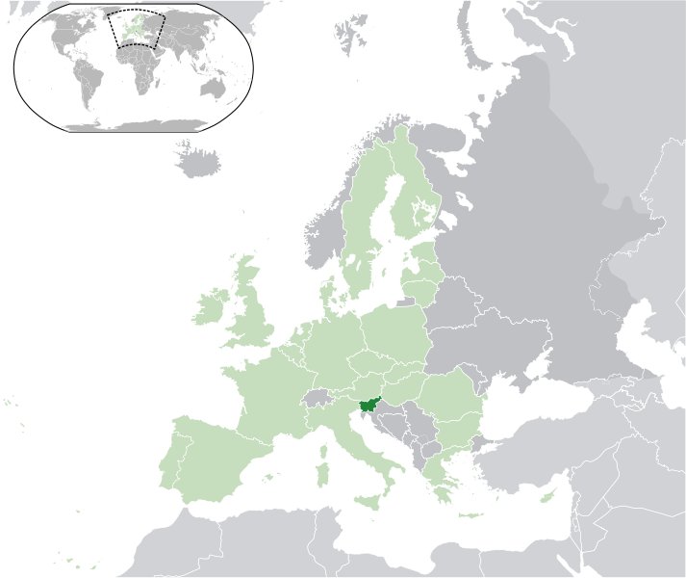
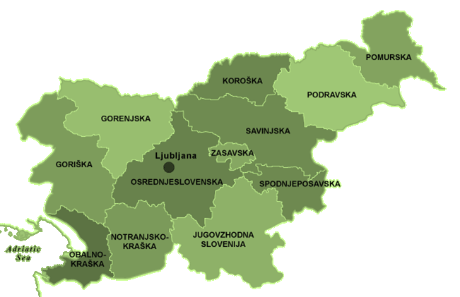
Indicators for Slovenia
Maribor
Ljubljana
General information
Capital | Ljubljana
Area (km2) | 20.273
Population (million) | 2.0
EU membership | 2004
Eurozone | 2007
Sovereign rating | A (negative)
Macroeconomic indicators | 2012 | 2011
GDP, per capita (EUR) | 17.457 | 17.620
GDP, real growth rate | -2,00% | 0,60%
Unemployment rate (ILO definition, average) | 11,90% | 11,80%
CPI, anuual average growth rate | 2,80% | 1,80%
Public debt of GDP | 48,20% | 44,30%
Novo mesto
Kosovo
Source: UMAR, Slovenia Economic Mirror, January 2013

Slide 4
Indicators for Slovenian Insurance market
Slovenian insurance market | 2011 | 2010
Gross premiums written (EUR '000) | 2,092,317 | 2,094,778
GPW - non-life (EUR '000) | 1,454,089 | 1,438,765
GPW - life (EUR '000) | 638,231 | 656,013
GPW - reinsurance (EUR '000) | 262,282 | 263,029
Loss ratio | 61,30% | 59,30%
Loss ratio (non-life) | 64,90% | 69,30%
Loss ratio (life) | 53,10% | 37,40%
Insurance penetration | 5,90% | 5,90%
GPW, per capita (EUR) | 1,046 | 1,047
Maribor
Ljubljana
Novo mesto
Source: Slovenian Insurance association, May 2012
Kosovo

Slide 5
Key features of Slovenian Insurance market
Mature market
Insured are loyal to local companies
Strong government involvement
Insurance companies are region specialized
Prone to cat events (EQ, Flood, Hail)
Strong local reinsurance (two companies)
Nuclear pool
Agents are bound to insurance companies
Maribor
Ljubljana
Novo mesto
Kosovo

Slide 6
History of Slovenian Insurance market development
Period up until 1918
1291 – 1765 Precursors of insurance companies (maritime loans, brotherhoods, guilds)
1766 – 1920s The founding of the first insurance companies
1918-1945 Kingdom of Serbs, Croats and Slovenes (Yugoslavia)
1922-1939 Four Slovenian insurance companies were found
1945-1990 DFRY, FPRY, SFR Yugoslavia
1946 State institute of Insurance and Reinsurance is found in Belgrade
1961 Founding of various municipal insurance companies in Slovenia
1967 Merging all insurance companies except Maribor into Sava Insurance Company
1976 Founding of Sava Reinsurance community
1977 Merging of Sava IC with Maribor IC into Triglav IC
Republic of Slovenia
1990 Transforming Triglav various regional offices into independent ICs
1990 Transformation of Sava Re into JSC
1992-1997 EU big insurance groups establish daughter companies in Slovenia (Merkur, Grawe, Generali)
1998 Founding of Triglav Re
2004 Establishing branch offices of EU Insurance groups (VIG, Alliance and etc.)
Maribor
Ljubljana
Novo mesto
Kosovo

Slide 7
Market development
Development of market participants
 | 2002 | 2003 | 2004 | 2005 | 2006 | 2007 | 2008 | 2009 | 2010 | 2011
Number of insurance companies | 16 | 17 | 17 | 17 | 18 | 18 | 18 | 20 | 21 | 21
Number of reinsurance companies | 2 | 2 | 2 | 2 | 2 | 2 | 2 | 2 | 2 | 2
Branches of insurance companies from EU | 0 | 0 | 0 | 2 | 2 | 2 | 2 | 3 | 3 | 3
Maribor
Ljubljana
Novo mesto
Kosovo

Slide 8
Market development
Insurance Premium and Claims development
Maribor
Ljubljana
Novo mesto
Kosovo

Slide 9
Market development
Reinsurance Premium and Claims development
Maribor
Ljubljana
Novo mesto
Kosovo

Slide 10
Motor insurance development
2nd biggest LOB, its share follows western patterns, not CEE ones
Number of vehicles increased 34% in 10 years
MTPL premium falls 15% a year since 2008 due to increased competition (due to foreign branches)
Line is still profitable due to radical improvements in traffic safety
Compensation levels are set to EU directive 5 initially
Maribor
Ljubljana
Novo mesto
Kosovo

Slide 11
History Cat losses for Sava Re Group
U/W YEAR | Date of Loss | Cause | Net Retained Loss fgu in EUR | Cedants
2012 | 5.-6.11.2012 | flood | 3 916 500 | Maribor, Tilia, Sava
2010 | 17.-20.9.2010 | flood | 4 932 490 | Maribor, Tilia, Sava
2009 | 3.-4.8.2009 | storm/hail | 1 657 885 | Maribor, Tilia, Sava
2009 | 16.-17.6.2009 | storm/hail | 4 257 224 | Maribor, Tilia, Sava
2009 | 25.-27.5.2009 | storm/hail | 4 425 962 | Maribor, Tilia, Sava
2009 | 27.01.2009 | snow pressure | 1 947 558 | Maribor, Sava
2008 | 15.08.2008 | storm/hail | 39 491 875 | Maribor, Tilia, Sava
2008 | 08.08.2008 | storm/hail | 3 150 583 | Maribor, Tilia, Sava
2008 | 13.-14.7.2008 | storm/hail | 9 500 713 | Maribor, Tilia, Sava
2007 | 18.09.2007 | torrent | 2 368 309 | Maribor, Tilia, Sava
2006 | 28.-30.6.2006 | storm/hail | 4 100 633 | Maribor,Tilia,Sava
2005 | 20.-21.8.2005 | flood | 735 454 | Tilia, Sava
2005 | 22.07.2005 | storm/hail | 1 035 883 | Tilia,Sava
2004 | 09.08.2004 | storm/hail | 1 599 624 | Maribor,Sava
2004 | 10.-12.6.2004 | storm/hail | 2 573 404 | Maribor,Tilia,Sava
2001 | 30.-31.5.2001 | storm/hail | 2 495 900 | Maribor,Tilia,Sava
Ljubljana
Novo mesto
NOTE: The following figures represent losses to Sava Group (Maribor, Tilia, SavaRe).
NOTE: Losses excluding crops, event losses exceeding 1.000.000 EUR f.g.u.
Kosovo

Slide 12
History Cat losses for Sava Re Group
2008 biggest cat loss for the group so far
Most frequent cat events are hail and flood
Hail brings most of the losses to the group
However Slovenia is quake prone (100 years ago Ljubljana was deserted)
U/W YEAR | Loss for the year | # of events
2012 | 3 916 500 | 1
2010 | 4 932 490 | 1
2009 | 12 288 629 | 4
2008 | 52 143 170 | 3
2007 | 2 368 309 | 1
2006 | 4 100 633 | 1
2005 | 1 771 337 | 2
2004 | 4 173 028 | 2
2001 | 2 495 900 | 1
Ljubljana
Novo mesto
Kosovo

Slide 13
Market shares
Companies | Total | Life | Non-life
Triglav | 33,89% | 33,70% | 33,97%
Adriatic Slovenica | 12,94% | 2,12% | 17,38%
Maribor | 12,84% | 12,64% | 12,92%
Vzajemna (medex) | 12,15% |  | 17,13%
KAD / Modra Zavarovalnica | 4,93% | 16,95%
Generali | 4,21% | 3,29% | 4,58%
Triglav, Zdravstvena | 3,91% |  | 5,51%
Tilia | 3,85% | 1,72% | 4,72%
KD Zivlenie / in 2013 became a part of Adriatic slovenica | 3,05% | 10,48%
Other | 8,25% | 19,10% | 3,80%
Total | 100,00% | 100,00% | 100,00%
Maribor
Ljubljana
Novo mesto
Kosovo

Slide 14
Premium split by lines of business
 | Gross premiums written |  | Gross claims |  | Loss ratio
Lines of business | 2011 | 2010 | 2011 | 2010 | 2011 | 2010
Total | 2 053 443 | 2 094 342 | 1288 696 | 1242 833 | 63% | 59%
- Non-life total | 1 454 084 | 1 438 329 | 943 954 | 997 209 | 65% | 69%
Health | 428 522 | 409 665 | 375 436 | 365 660 | 88% | 89%
Motor vehicle liability | 283 414 | 302 868 | 155 164 | 169 049 | 55% | 56%
Land motor vehicles casco | 254 495 | 254 216 | 178 729 | 195 454 | 70% | 77%
Other damage to property | 142 799 | 136 789 | 72 645 | 83 247 | 51% | 61%
Accident | 103 608 | 107 012 | 37 690 | 39 963 | 36% | 37%
Fire and allied perils | 98 816 | 94 701 | 40 138 | 51 971 | 41% | 55%
Other liability | 52 749 | 50 044 | 27 923 | 26 624 | 53% | 53%
Credit | 44 415 | 46 157 | 38 105 | 45 900 | 86% | 99%
Tourist assistance | 18 206 | 12 501 | 7 767 | 6 824 | 43% | 55%
Other | 27 060 | 24 376 | 10 357 | 12 517 | 38% | 51%
- Life total | 599 360 | 656 013 | 344 742 | 245 624 | 58% | 37%
Unit-link | 350 049 | 404 727 | 136 345 | 71 254 | 39% | 18%
Life insurance | 228 359 | 228 413 | 182 273 | 169 844 | 80% | 74%
Other | 371 001 | 427 600 | 162 469 | 75 780 | 44% | 18%
Maribor
Ljubljana
Novo mesto
Kosovo

Slide 15
Premium split by lines of business
Maribor
Ljubljana
Novo mesto
Kosovo

Slide 16
Operating efficiency of (re)insurance companies in 2011
 | Number of employees | Gross premium written
 |  | Total | Per employee
 |  | EUR 1000 | EUR 1000
Total employees in the sector | 6 207 | - | -
Reinsurance companies | 108 | 262 282 | 2 429
- Triglav Re | 37 | 121 932 | 3 295
- Sava Re | 71 | 140 350 | 1 977
Insurance companies | 6 099 | 2 053 443 | 337
- Triglav | 2 400 | 694 962 | 290
- Adriatic Slovenica | 998 | 265 301 | 266
- Maribor | 875 | 263 244 | 301
- Vzajemna (medex) | 292 | 249 075 | 853
- KAD / Modra Zavarovalnica | 53 | 101 053 | 1 907
- Generali | 330 | 86 235 | 261
- Triglav, Zdravstvena | 78 | 80 190 | 1 028
- Tilia | 382 | 78 893 | 207
- KD Zivlenie / in 2013 merged to Adriatic Slovenica | 177 | 62 488 | 353
Maribor
Ljubljana
Novo mesto
Kosovo

Slide 17
Insurance business in Slovenia 2011 and in selected countries 2010
Country | # of |  | premium |  | Premium/Inhabitant |  | Premium on GDP (%) | Premium /
 | Insurance companies | Employees | Total (EUR m) | Share of life(%) | Total (EUR) | Life (EUR) |  | company (EUR m) | employee (EUR)
Switzerland | 151 | 45.659 | 39.897 | 54,7% | 5.071 | 2.775 | 10,0% | 264 | 873.804
Denmark | 184 | 16.773 | 20.917 | 71,4% | 3.769 | 2.686 | 8,9% | 114 | 1.247.064
Belgium | 145 | 23.727 | 29.414 | 64,9% | 2.694 | 1.750 | 8,3% | 203 | 1.239.685
Italy | 242 | 47.185 | 125.954 | 71,5% | 2.078 | 1.486 | 8,1% | 520 | 2.669.365
EU(27) | 4.886 | 868.484 | 1.035.106 | 61,6% | 2.073 | 1.278 | 8,5% | 212 | 1.191.854
Austria | 127 | 26.538 | 16.748 | 45,1% | 1.993 | 899 | 5,9% | 132 | 631.095
Portugal | 82 | 11.234 | 16.342 | 74,5% | 1.536 | 1.144 | 9,5% | 199 | 1.455.987
Slovenia | 19 | 6.099 | 2.053 | 29,2% | 1.000 | 292 | 5,8% | 108 | 336.613
Greece | 73 | 9.000 | 5.236 | 44,1% | 462 | 204 | 2,3% | 72 | 581.778
Hungary | 32 | 25.003 | 3.063 | 52,4% | 307 | 161 | 3,2% | 96 | 122.505
Croatia | 23 | 11.085 | 1.269 | 26,6% | 287 | 76 | 2,8% | 55 | 114.479
Turkey | 64 | 16.683 | 7.077 | 15,4% | 96 | 15 | 1,3% | 111 | 424.204
Ljubljana
Novo mesto
Kosovo

Slide 18
Thank you for your attention.

