Slide 1
Investment potential of the Republic of Uzbekistan and created favourable investment conditions for foreign investors
Mr. Shavkat Tulyaganov
Deputy Minister of the Ministry for Foreign Economic Relations, Investment and Trade of the Republic of Uzbekistan
April, 2013

Slide 2
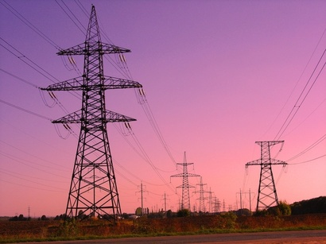
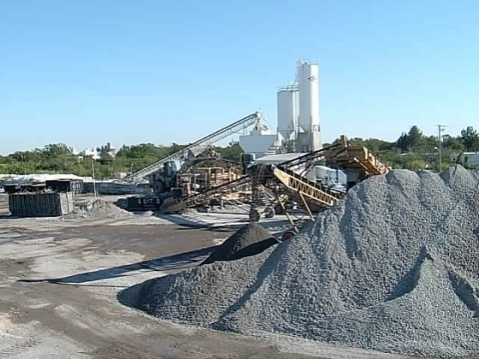
Factors of success in attraction of investments
in Uzbekistan
1. Political & macroeconomic stability
2. Sound legal base
3. Rich raw material base
4. Energy advantageous
5. Diversified industrial base
6. Advantageous geographical location
7. Well educated human resources

Slide 3
Main macroeconomic parameters
GDP growth
(% to previous year)
Inflation rate
Notes:
The strategy adopted to combat the crisis and to reverse its effects has allowed our country to be among the few countries in the world that have managed to ensure sustainable economic development and promote sectors of the republic economy.
GDP growth over the past 3 years exceeds - 8.0%.
Sustained high economic growth (an average of 7-9% per year) were provided mainly by domestic factors:
- For the period of independent development of GDP at purchasing power parity has grown by 3.5 times;
- The volume of industrial production for years 1990-2010 has increased by 3 times;
- Over the past 20 years, provided the growth of agricultural output by 1.8 times;
- High investment rates (at 25% of GDP) are provided mainly by domestic sources;
- Ensured stable growth of incomes (at 22-24% per annum) and domestic demand for goods and services.

Slide 4
Sound legal base
Over 50 normative legal documents on regulating of investment
activity adopted in Uzbekistan
Law “On Foreign Investments” in 1998
Law "On Investment Activity” in 1998
Law "On Guarantees and Measures to Protect the Rights of Foreign Investors” in 1998
6 legal documents on regulating of investment
and business activity adopted in Uzbekistan in 2012
Decree of the President of Uzbekistan «On additional measures to stimulate attracting foreign direct investments» #UP-4434, April 2012
Decree of the President of the Republic of Uzbekistan #1731 "On additional measures for stimulation of export manufacturers and expansion of export supplies of competitive output”, March 2012

Slide 5
Decree of the President of Uzbekistan
«On additional measures to stimulate attracting
foreign direct investments» #UP-4434
1. Enterprises with the investment volume for at least 5 million USD reserve the right to pay for 10 years for all type of taxes that operated at the date of their registration
2. Investment projects
more than 50 million USD
share of foreign investors no less than 50%,
external engineering-communication networks will be provided by state budget.
3. Selling low liquid state objects at zero redemption cost through signing direct contracts with the investor under concrete investment obligations
4. Obtaining of multiply visa for a period of 12 months

Slide 6
Decree of the President of Uzbekistan
«On additional measures to stimulate attracting
foreign direct investments» #UP-4434
5. Extension of incentives and privileges of the President’s Decree #UP-3594 on April 11, 2005
I. For all regions of Uzbekistan (except Tashkent region and Tashkent city)
II. Tax and obligatory payments exemption
Period of Tax Exemptions :
3 years, if amount of direct investments is 0,3 - 3 mln. USD;
5 years, if amount of direct investments is 3 - 10 mln. USD;
7 years, if amount of direct investments is more than 10 mln. USD.

Slide 7
Decree of the President of Uzbekistan
«On measures on radical reduction of statistics,
tax, financial reporting, licensable businesses
as well as permit issues procedures» #UP-4453
In accordance with the Decree, 80 licensing procedures (26% of the total number) and 15 licensable activities (20%) is abolished in Uzbekistan since August 1, 2012 through their cancellation and integration.

Slide 8
Decree of the President of Uzbekistan
«On measures on further cardinal improvement
of business environment and providing
more freedom to entrepreneurship» #UP-4455
- payment of taxes and other mandatory payments via remote service for bank accounts, including Internet Banking;
declaration of goods by the business entities at the custom clearance of goods;
registration of ownership of legal entities for real estate through "one-stop shop" approach;
submission of claims and applications of business entities to economic courts.

Slide 9
Decree #245 “On measures to develop and
strengthen off-the-board exchange market”
1. Enterprises are exempt from obligatory sale of foreign exchange earnings:
a) for a period of five year's from the moment of the registration of enterprise, involved in production of consumer goods and, where share of foreign capital exceeds 50%;
b) by microfirms, small and medium enterprises, from export of goods of own production
c) ​​investments in the form of cash in foreign currency in the sale of state assets with investment commitments
Notes:
We developed sound and up to date legal base and provide broad system of preferences and benefits for foreign investors.
Legal base for foreign investor at least not worse but in most better than for local companies
Over 50 normative legal documents on regulating of investment activity adopted in Uzbekistan
Basic laws is:
Depending on volume of investment, industry and region as well as share of export foreign investors are exempted from paying custom duties and get incentives for taxes and other payments. For certain period of time. VAT exemption.

Slide 10
Decree #245 "On measures to develop and
strengthen off-the-board exchange market”
2. Foreign exchange earnings liable to obligatory sale are reduced:
a) in amount of expenses, incurred in foreign exchange under the contracts, associated with the procedure of customs outside of the Republic of Uzbekistan, transportation, insurance, freight forwarding, commissions, amount of payment on interests for credits;
b) in amount of foreign exchange costs, used to purchase raw materials within the country in foreign currency, needed for the production of export products for enterprises, which are allowed as an exception to purchase raw materials in foreign currency in the territory of the Republic of Uzbekistan
Notes:
We developed sound and up to date legal base and provide broad system of preferences and benefits for foreign investors.
Legal base for foreign investor at least not worse but in most better than for local companies
Over 50 normative legal documents on regulating of investment activity adopted in Uzbekistan
Basic laws is:
Depending on volume of investment, industry and region as well as share of export foreign investors are exempted from paying custom duties and get incentives for taxes and other payments. For certain period of time. VAT exemption.

Slide 11
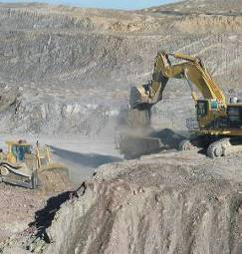
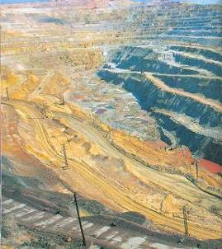
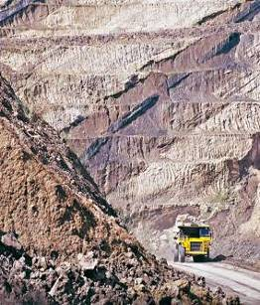
Rich raw material base
Uzbekistan possesses unique resources:
solid raw materials, including ferrous and non-ferrous
Over 1644 of deposits and 100 sorts of mineral resources

Slide 12
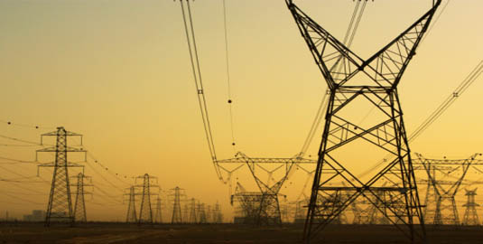
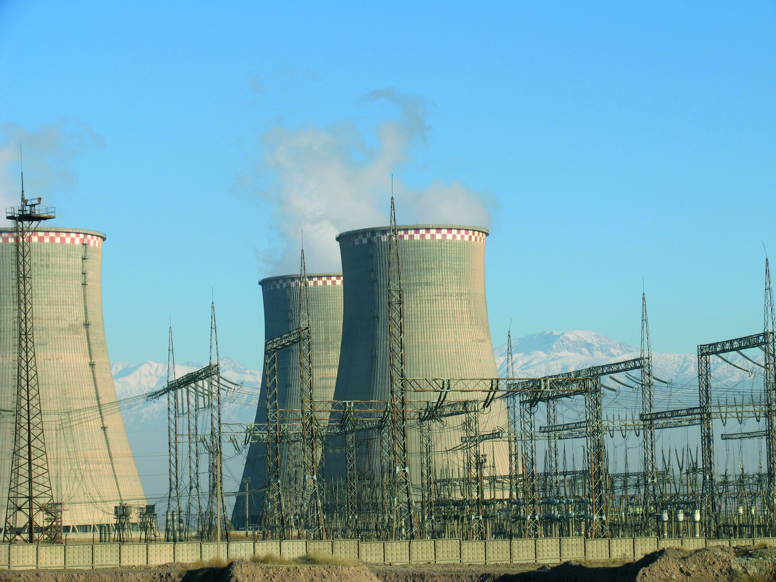
Energy advantageous
13 thermal stations and 28 hydropower plants fully provide the needs of the economy.
Total energy capacity 12 472 MWt
Additional capacity – 1 101 MWt (2013-2016)
Coal reserves – 80-100 years
Alternative energy sources
in Uzbekistan:
Average prices for:
solar energy
Electricity - $0.05 per kWt/h
wind energy
biofuel
Gas - $56 per 1000 m3
Coal - $21 per 1 ton
Water - $0.12 per 1 m3

Slide 13
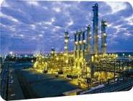
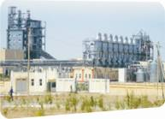
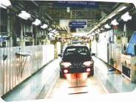
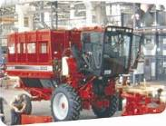
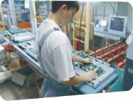
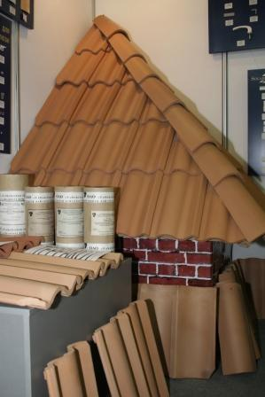
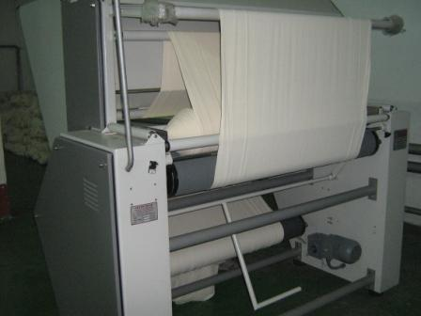
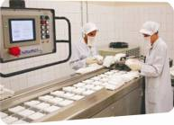
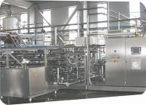
Diversified industrial base
Oil, gas & petrochemical
Chemical
Mining & metallurgy
Automobile
Agricultural
machinery
Electrical
engineering
Electronics
Construction materials
Textiles
Pharmaceuticals
Food processing

Slide 14
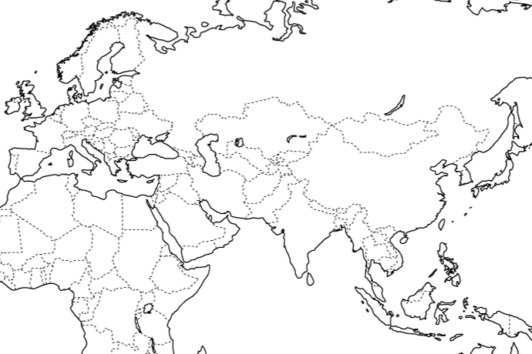
Central geographical location to the largest markets
CA & Afghanistan: 90 mln. people
CIS
CIS: 300 mln. people
Europe
Moscow
Central Asia
Minsk
London
Berlin
Kiev
Astana
East Asia
Brussels
Paris
Ashgabat
Bishkek
Beijing
Ankara
Tokyo
Baghdad
Tehran
Seoul
Jerusalem
Kabul
Shanghai
Amman
Cairo
Doha
Middle East & Africa
Riyadh
South-East and South Asia
Abu Dhabi
Muscat
Most Favorable Nation
Treatment
Bangkok
Manila
Phnom Penh
Singapore
with 45 countries, including US, EU countries, Japan, China, India,
Republic of Korea, and others
Jakarta

Slide 15
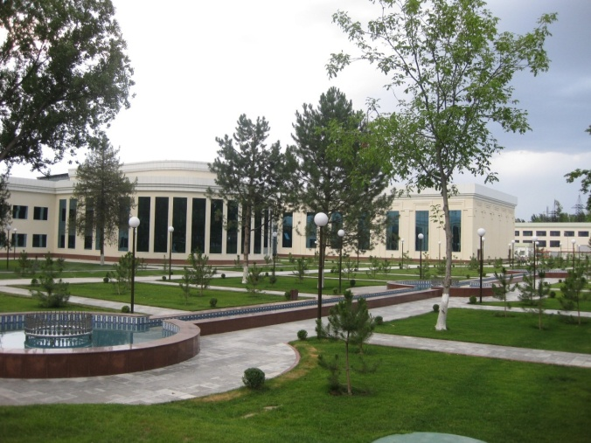
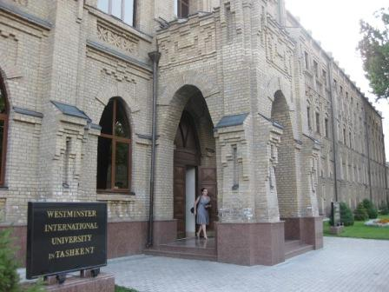
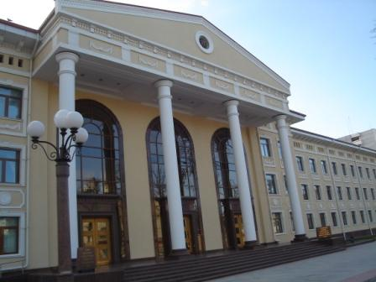
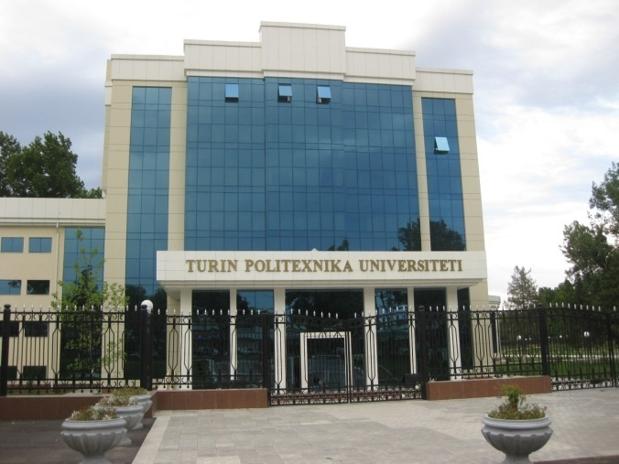
Well educated human resources
65 universities and institutions
850 directions
300 thousand students
affiliates branches of foreign universities:
Westminster International University
Singapore Institute of Management Development
Turin Polytechnic Institute
Oil&Gas Institute named after Gubkin
Moscow State University
Russian Economic University named after Plekhanov

Slide 16
Foreign investments in Uzbekistan
3629
3284
2942
1882
1286
748
896
755
602
448

Slide 17
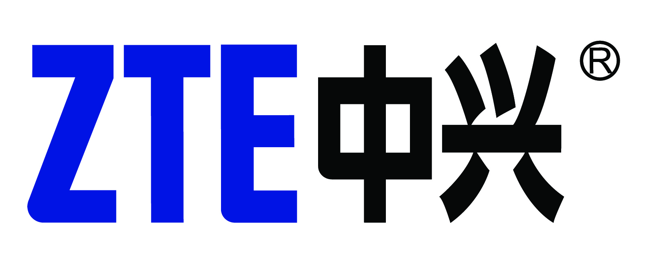
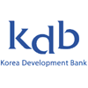
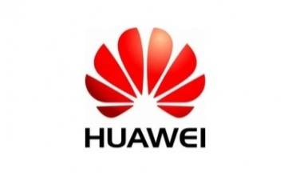
Foreign enterprises in Uzbekistan
CNPC
over 4500 enterprises with foreign capital

Slide 18
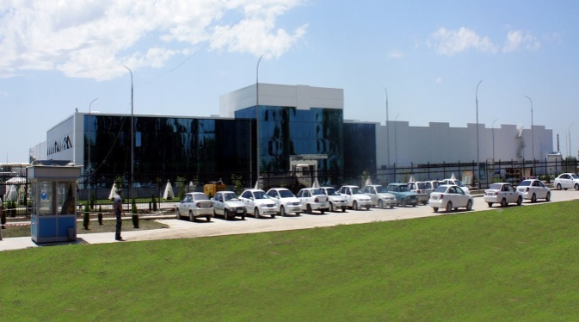
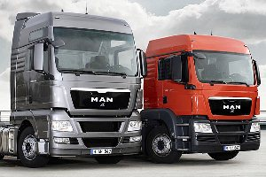
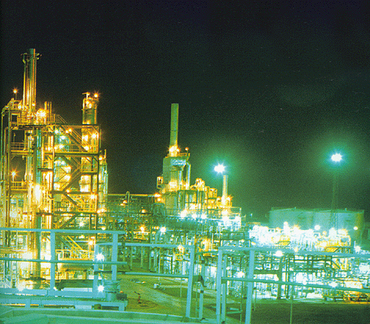
Newly implemented investment projects
Steam-gas plant on Navoi thermal power-station in cooperation with Japan “Mitsubishi”
Production of engines for automobiles jointly with GM
Second stage of a new complex for the production of trucks in cooperation with German “MAN”
Construction of an unique complex “Ustyurt Mubarek Gas Processing Plant” on the base of Surgil field in cooperation with Korean companies consortium started in 2012
First stage of liquefied gas production on the base of “Mubarek Gas Processing Plant”

Slide 19
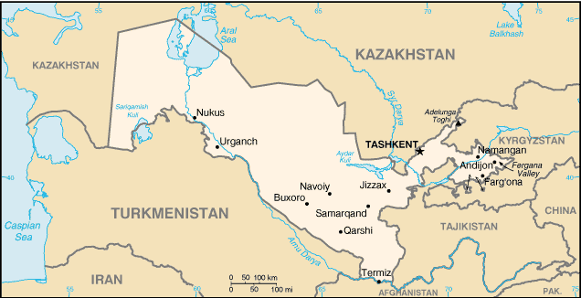
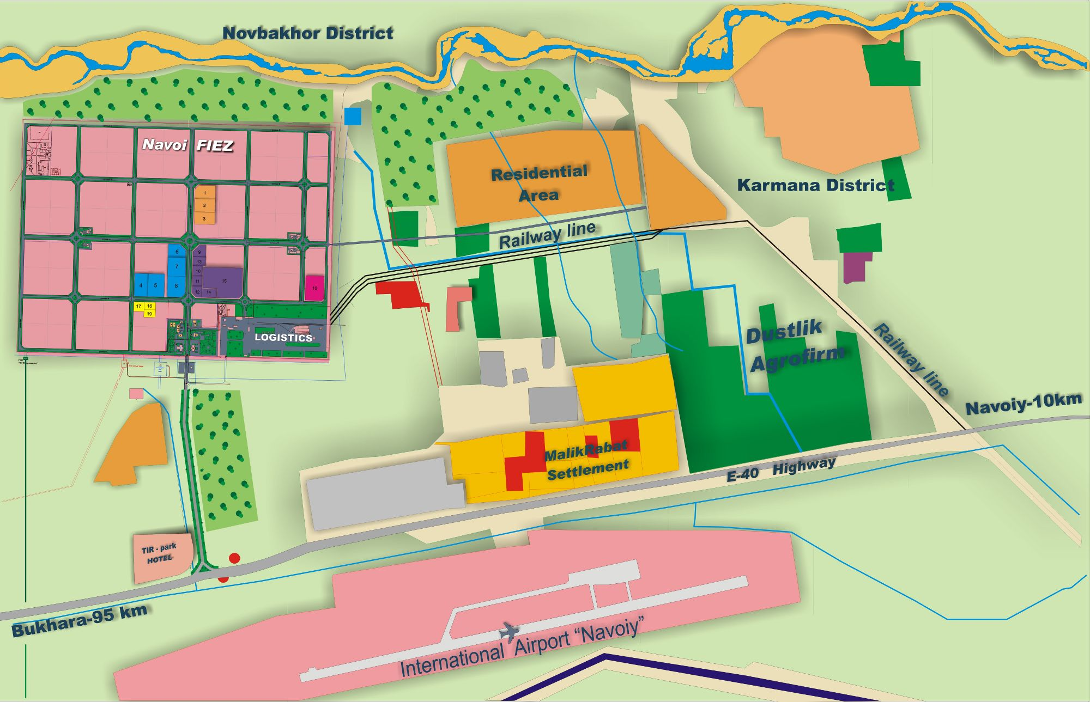
FIEZ “Navoi”
Establishment of Free Industrial Economic Zone “Navoi”
(Degree of the President of the Republic of Uzbekistan December 2, 2008)
Territory - 564 ha
Destination to:
Airport – 2 km
KAL Complex – 2 km
Tashkent – 480 km
Bukhara – 95 km

Slide 20
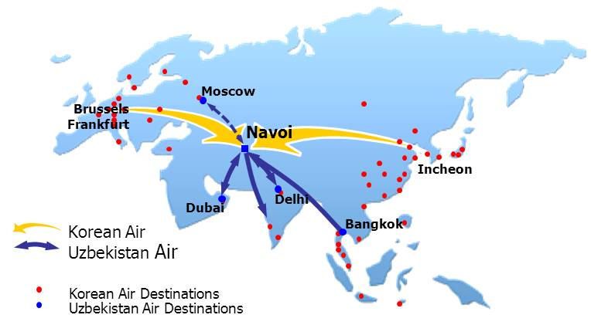
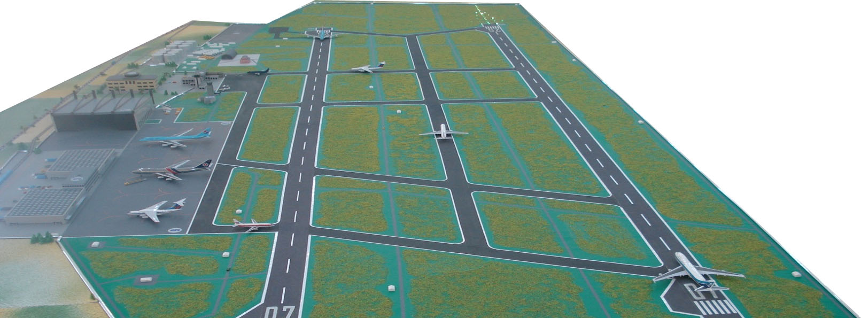
“Navoi” International Airport
29 flights per week
(Delhi, Mumbai, Bangkok, Frankfurt, Istanbul, Dubai, Doha, Dhaka, Hanoi, Moscow, Milan, Brussels, Vienna, Zaragoza, Incheon, Paris)
1st stage – Cargo processing ability – 300 tons/day
2nd stage – Cargo processing ability –1000 tons/day

Slide 21
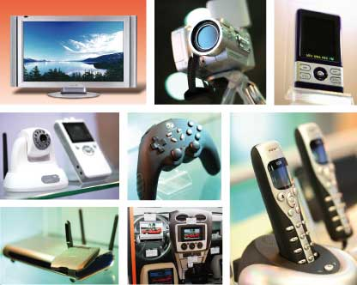
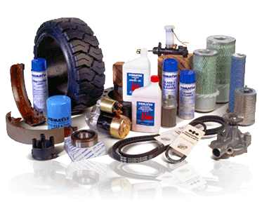
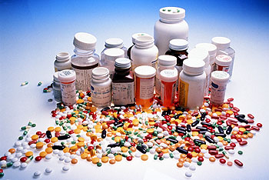
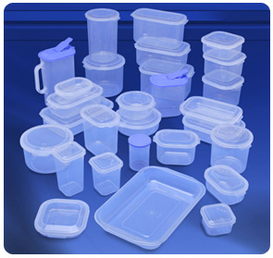
FIEZ “Navoi”: Profile
Electronic & electrical products
Precision machinery & OEM parts for automobiles
Pharmaceutical industry & Medical products
Food processing and packaging
Plastic goods and polymers

Slide 22
FIEZ “Navoi”: Tax preferences
Navoi FIEZ residents are exempted from all type of tax and custom duties (except custom fees)
7 years
if amount of direct investments is from 3 mln to 10 mln euro
10 years and 50% reduction of profit tax for the following 5 years
if amount of direct investments is from 10 mln to 30 mln euro
15 years and 50% reduction of profit tax for the following 10 years if amount of direct investments is more than 30 mln euro

Slide 23
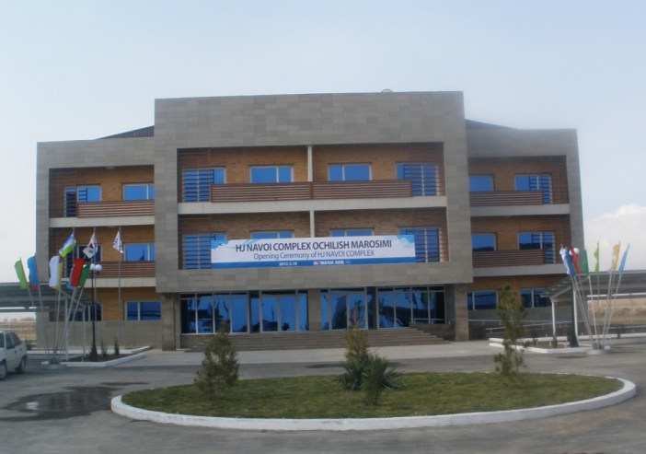
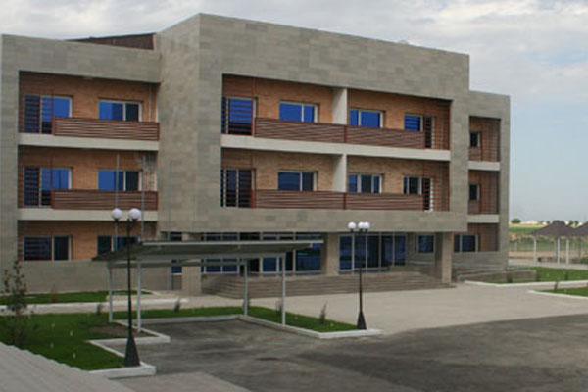
FIEZ “Navoi”: Development of social infrastructure
March 19, 2012 held the opening ceremony of the Navoi complex
1.2 km from Navoi FIEZ
120 hectares of land
3 residential units
51 rooms (41- standard, 8 – twin-bedded, 2- VIP, restaurant, gym, common rooms and others)

Slide 24
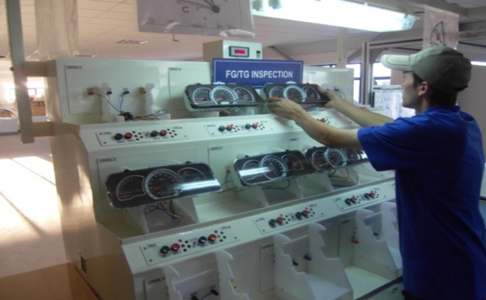
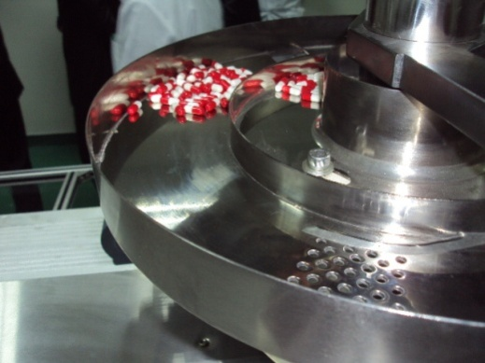
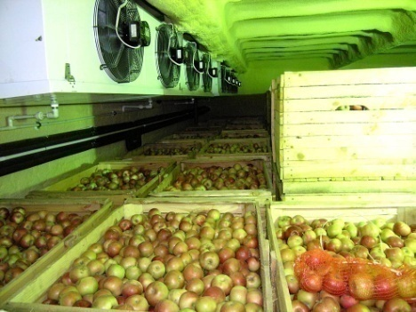
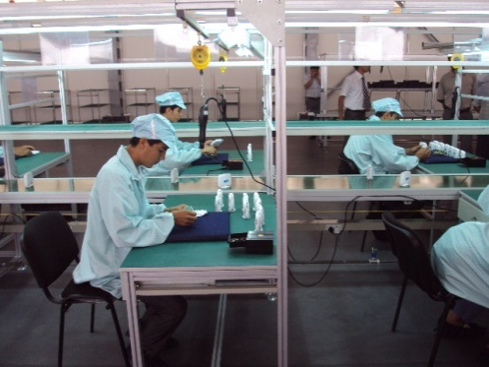
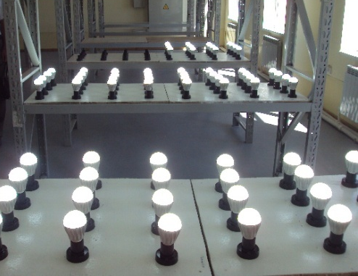
FIEZ “Navoi”: Current projects
12 operating projects
Enterprises working in FIEZ “Navoi”
started production of such good as:
Automobile components
LED lams
ADSL modems
Set-up boxes
Polyethylene pipes
10 projects in progress
48 new projects
Notes:
As seen above, to create FIEZ in Uzbekistan based on the study of international experience, the work has been done, during which they provided all the possible factors that contribute for attracting foreign companies to set their productions in FIEZ and its effective development. Evidence of this is greatly increasing interest in the project of creation of FIEZ in Uzbekistan from a number of foreign companies. To 12 projects at present has already begun production of such export-oriented products such as digital tuners for television, cable and automotive components, generators, fresh and processed using modern technology of freezing fruits and vegetables, as well as polymer and polyethylene pipes and beauty products.
Foreign partners in these projects represent a wide range of countries such as Korea, China, USA, Germany, Singapore, UAE and Oman. At these enterprises provided employment of more than 1.5 thousand employees and an annual production of 800 million U.S. dollars with exports more than 50% of production.
We are planning to launch about 21 new enterprises next year.

Slide 25
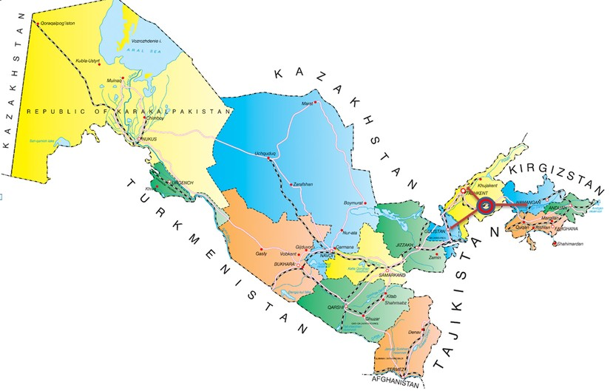
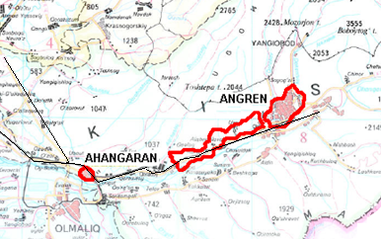
Special industrial zone “Angren”
Establishment of Special Economic Zone “Angren“
(Degree of the President of the Republic of Uzbekistan April 10, 2012 No.UP-4436)
500 ha
Distance between large cities:
Tashkent – 80 km
Ferghana – 240 km
178 ha
Total territory of SIZ “Angren” – 1634 ha

Slide 26
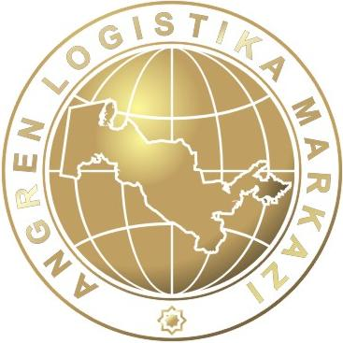
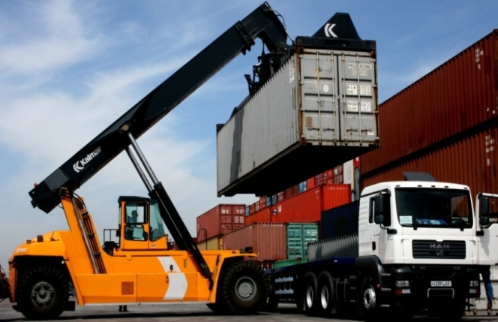
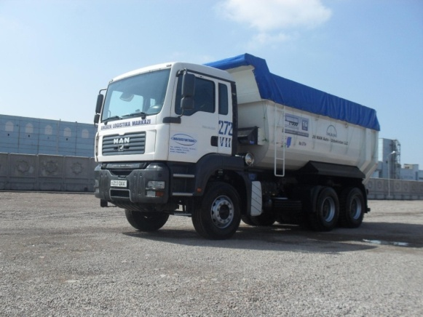
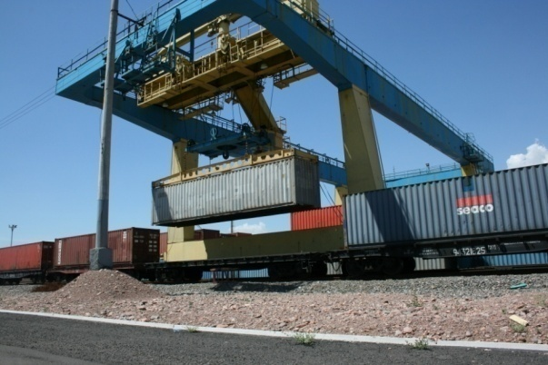
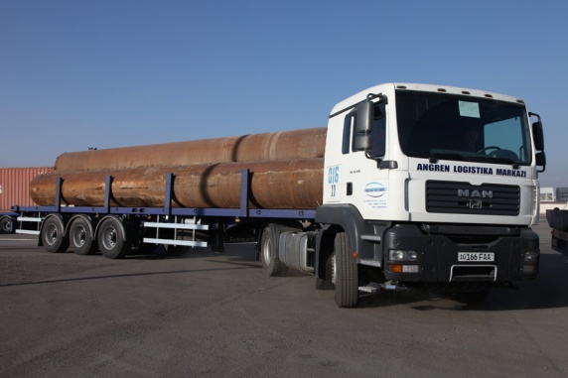
SIZ “Angren”: Logistic center
Creating a competitive advantage for the country in the international logistics market
Capacity of storage facilities 5,4 mln. tn./year
Total area 36,7 ga
Registered 310 vehicles
Notes:
26

Slide 27
SIZ “Angren”: Tax preferences and incentives
SIZ “Angren” residents are exempted from all type of tax and custom duties (except custom fees):
Period of privileges and incentives:
3 years
if amount of direct investments is from 0.3 mln to 3 mln USD
5 years
if amount of direct investments is from 3 mln to 10 mln USD
7 years
if amount of direct investments is more than 10 mln. USD

Slide 28
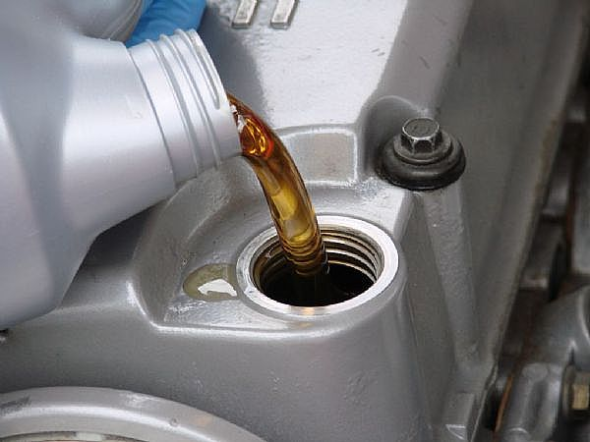
SIZ “Angren”: Current projects
Synthetic motor oil
Automobile tires
Sugar plant
Ceramic tile
Silicon

Slide 29
SIZ “Djizzak”
Establishment of Special Industrial Zone “Djizzak” Decree of the President of the Republic of Uzbekistan from 18 March, 2013, #UP-4516
Area – 344,0 hectares
Total area of SIZ “Djizak” is 452,0 hectares: located at the centre of Djizak city and has its branch in Syrdarya district of Syrdarya region
Distance up to Tashkent – 180 km

Slide 30
Branch of SIZ “Djizzak” in Syrdarya district of Syrdarya region
Distance up to Tashkent – 118 km
The total area – 108,0 hectares

Slide 31
SIZ “Djizzak”: Tax preferences and incentives
SIZ “Djizzak” residents are exempted from all type of tax and custom duties (except custom fees):
Period of privileges and incentives:
3 years
if amount of direct investments is from 0.3 mln to 3 mln USD
5 years
if amount of direct investments is from 3 mln to 10 mln USD
7 years
if amount of direct investments is more than 10 mln. USD

Slide 32
Perspective investment proposals for joint cooperation
Electro technical industry
(production of household and electrical appliances, water heating system (collectors) and etc.)
Mechanical and instrumental engineering
(production of compact equipments, road building and municipal machines and etc.)
Chemical industry
(production of coatings for floors, walls and ceilings plates, sheets, film and others, children’s toys made of polymers and etc.)
Building materials industry
(production of flat glass, sanitary ware products, ceramic granite slabs and etc.)

Slide 33
Perspective investment proposals for joint cooperation
Light industry
(production of hosiery products, shoes, accessories made of plastic and etc.)
Pharmaceutical and medical products
(production of vials and ampoules, disposable tests and etc.)
Food industry
(production of freeze fast foods, confectionery products and etc.)
Other directions
(production of household porcelain and kitchen appliances and etc.)

Slide 34
Thank you!
www.investuzbekistan.uz
www.fiez.uz
www.exporter.uz

