Slide 1
IFC Experience in Leasing Presentation at the 5th Tashkent International Leasing Conference
Raiomand Billimoria
Project Manager
April, 2012
rbillimoria@ifc.org

Slide 2
40 Year Commitment to Leasing
A Core Component of IFC’s FM Strategy - Increase access to financing to Small & Medium Businesses - Broaden the range of financial services available in Emerging Markets
A Historic Focus Area - Financed 234 leasing projects in 60 countries for $1.56 billion over 40 years - IFC has participated in the set-up of the first leasing company in 30 countries
Set-up or improved leasing regulations in 94 countries - IFC has operated 59 Leasing advisory projects across the globe with $29 million of its own funding leveraged with Donor funding. Legal & Regulatory framework, Market Research, Institution Building, Public Awareness, Promotion of local and foreign investment

Slide 3
Historic/Current Commitments
Leasing Investment Portfolio (FY2010)
$542.23 million

Slide 4
Examples of Typical IFC Leasing Interventions
Help local banks create leasing operations
Bringing technical partners and acting as honest broker in JV
Combining debt or risk sharing with advisory services
Invest in start-up or existing leasing companies
Equity and quasi equity, debt, structured finance
Foster SME Financing through advisory services and performance-based grants
Help multinational players invest in emerging markets
Bringing IFC political umbrella, local knowledge, risk mitigation
Develop sustainable financing products
Micro, Small and Medium Enterprise financing
Energy Efficiency, Clean Production and Renewable Energy lines of credit
Agriculture Equipment Financing, Gender, etc

Slide 5
Key Lessor Success Factors
Key Lessor Success Factors
Excellent Management
- Credit Risk Management: High standards of cash-flow analysis
- Asset-Liability Management
- Internal Control and Financial Control
Sound Strategy
- Growth perspectives, diversified portfolio and funding sources
- Competitive niche and natural market share for stand-alone leasing companies i.e. independent from banking groups)
Financial Strength and Profitability
- Equity, leverage, return on assets
- Access to sustainable local currency term financing
Stable and Conducive Environment
- Regulatory framework establishing level-playing field for Leasing
- Contract enforcement, property rights, efficient judicial system

Slide 6
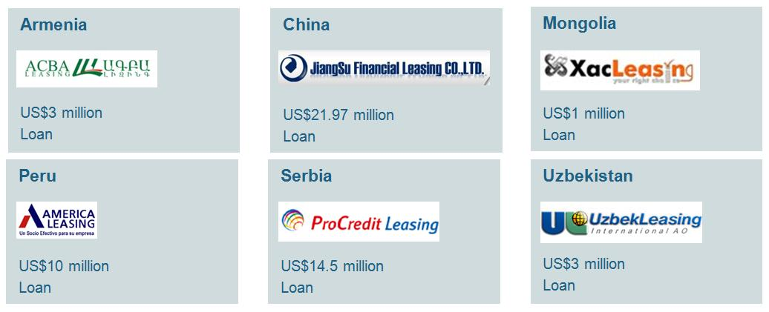
Sample IFC Leasing Projects
Russia
BSGV Leasing
US$70 million
Loan
Oman
Taageer Oman
US$10 million
Loan
Pakistan
Orix Leasing
US$17 million
Loan
Kazakhstan
BCC
US$10 million
Loan
Turkey
Intercity
US$48 million
Loan, Equity
Maldives
MFLC
US$3 million
Loan, Equity

Slide 7
The Global Leasing Toolkit
A comprehensive Working Manual to provide a practical guide to manage and operate a Leasing entity targeting the SME market.
- Universally accepted Principles and Best Practices
- Targeted at Bank and Non-Bank Financial Inst.
- MFIs, Equipment Sellers (Vendors), Private Equity Inst.
Draws on IFC’s 35 years of experience supporting equipment leasing entities in emerging markets
- Team of Experienced IFC staff, Diverse Backgrounds and Regions
Practical experience of external Leasing Professionals
Respond to New Markets
- Sustainable Energy Equipment Leasing
- Agricultural Equipment Leasing
- Islamic Finance

Slide 8
IFC is using risk management tools to assist financial institutions to profitably and sustainably finance agriculture
Advisory Services Solutions:
Example of AGRAM
# | Crops | Yield | Income | Expenses | Profit
1 | Cotton | 24 | $ 1,812.54 | $1,266.04 | $ 546.49
 |  | 30 | $ 2,265.67 | $1,371.60 | $ 894.07
 |  | 35 | $ 2,643.28 | $1,487.00 | $ 1,156.28
2 | Wheat | 30 | $ 1,182.85 | $ 953.70 | $ 229.15
 |  | 40 | $ 1,577.13 | $ 878.17 | $ 698.96
3 | Rice | 35 | $ 4,579.89 | $1,111.99 | $ 3,467.90
 |  | 40 | $ 5,234.16 | $1,296.17 | $ 3,937.99
4 | Onion | 300 | $ 8,708.68 | $2,469.73 | $ 6,238.95
 |  | 500 | $14,514.46 | $3,315.86 | $11,198.60
5 | Potato | 350 | $ 8,918.73 | $2,743.90 | $ 6,174.83
 |  | 450 | $11,466.94 | $2,497.98 | $ 8,968.96
6 | Tomato | 300 | $ 8,739.67 | $1,615.96 | $ 7,123.71
 |  | 400 | $11,652.89 | $2,080.84 | $ 9,572.05
7 | Barley | 30 | $ 1,043.39 | $ 761.19 | $ 282.20
8 | Corn | 30 | $ 1,229.34 | $ 873.14 | $ 356.20
9 | Chick-pea | 20 | $ 2,754.82 | $ 798.40 | $ 1,956.42
10 | Haricot | 13 | $ 1,074.38 | $ 800.07 | $ 274.31
11 | Green gram | 18 | $ 2,479.34 | $ 675.35 | $ 1,803.99
12 | Aubergine | 500 | $10,330.58 | $1,794.18 | $ 8,536.40
13 | Pepper | 200 | $ 6,887.05 | $1,529.87 | $ 5,357.18
14 | Cabbage | 300 | $ 8,677.69 | $1,471.91 | $ 7,205.77
15 | Garlic | 100 | $16,873.28 | $3,093.40 | $13,779.88
16 | Cucumber | 500 | $16,873.28 | $2,176.54 | $14,696.74
17 | Watermelon | 350 | $ 4,579.89 | $1,241.01 | $ 3,338.88
18 | Melon | 400 | $ 7,438.02 | $1,281.71 | $ 6,156.31
19 | Carrot | 300 | $ 7,024.79 | $1,234.14 | $ 5,790.65
20 | Lucerne 1 year | 400 | $ 1,455.10 | $1,024.24 | $ 1,455.10
Strengthening potential clients:
Trainings for farmers on productivity
Training on better working conditions, with a focus on gender
Training on financial literacy
Develop new financial tools
Bank Solutions:
Develop sound credit methodologies and provide training on new credit processes
Provide training on agricultural financing
Develop risk mitigation tools, e.g. AGRAM
Design new lending products
Source strong potential clients

Slide 9
Advisory Services Activity in Central Asia
Since 2005, IFC has been involved in developing the leasing market in Central Asia through the Central Asia Leasing Development Project and the Central Asia and Azerbaijan Lease Financing Fund. Results: Over 8 laws drafted including contribution to the new Tax Codes in the Kyrgyz Republic and Uzbekistan; over $275 million in leasing market growth in Azerbaijan and Central Asia; and over $37 million in additional investment raised by partners.
The existing advisory services project in Central Asia, TAFBEP, is in Tajikistan in the area of agricultural-equipment leasing. TAFBEP looks to increase access to finance for farmers through the development of the market for leasing of agricultural equipment. TAFBEP is working with two MFIs and one bank to develop leasing methodologies and procedures, and identify potential clients.
In 2013, it is likely that IFC will introduce a new regional project in Central Asia, focusing on Kyrgyz Republic, Tajikistan and Uzbekistan. The project may include agri-leasing, as well as working capital finance for agricultural lending. IFC will look to work with financial institutions (banks, micro-finance institutions and leasing companies) in these three countries in order to increase financing for agriculture.

