Slide 1
FEAS and Euro-Asian Markets

Slide 2
What is FEAS?
Federation of Euro-Asian Stock Exchanges (FEAS)
established with its head quarters in Istanbul on 16 May 1995 with 12 founding members
it has grown to 34 members and 15 affiliate members in 28 countries
Membership in the Federation is open to exchanges in Europe and Asia as affiliate membership is available for post trade institutions and dealer associations
The mission of FEAS is to help create fair, efficient and transparent market environments among FEAS members and in their operating regions
Minimize barriers to trade through the adoption of best practices for listing, trading and settlement.
Support promoting linkages among members for cross-border trading.

Slide 3
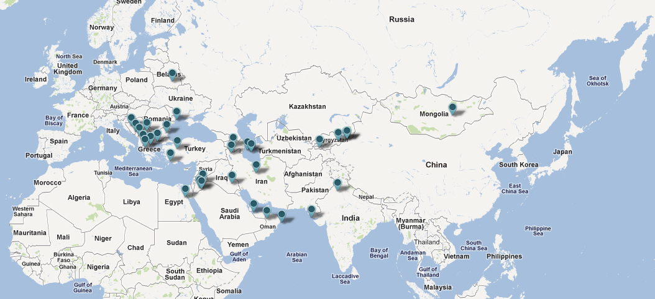
34 Exchange Members and 15 Affiliate Members in 28 countries

Slide 4
Membership Profile
34 Exchanges
29 hosting stocks trading, 20 Bonds, 2 Currency, 8 Derivatives, 2 Commodity, 20 Multiple asset classes
Exchanges’ statutory profile (15% demutualized, 31 % Private, 12% Public, 8% Association, 35% Other)
8 Post trading institutitons
4 Brokers Dealers Association
3 Multilateral bodies (AFE, SAFE, SOFA)
Regional breakdown (exchanges and others)
Exchanges (39% Europe, 36% Asia, 25% Middle East)
Post Trade (50% Europe, 13% Asia, 37% Middle East)
Broker Dealer Association (25% Europe, 25% Asia, 50% Middle East)
Multilateral Bodies (33% Europe, 33% Asia, 33% Middle East)

Slide 5
Defined Goals
Defined strategic plan dwells on regionally mutual goals for the members:
Objective I: Promote good “corporate governance” for exchanges, brokerage companies and listed companies. Facilitate timely disclosure of material events to achieve transparency through effective dissemination of information.
Objective II: Encourage convergence among FEAS Members in their: listing requirements, trading rules technical infrastructure and settlement cycle.
Objective III: Promote mechanisms for reliable, transparent and uninterrupted securities trading and settlement.
Objective IV: Create greater recognition and visibility for the region’s securities and investment opportunities both locally and internationally.
5

Slide 6
Defined Goals (cont’d)
Objective V: Encourage the listing of “investment grade” securities in the respective home markets of the Region.
Objective VI: Encourage foreign investor participation in Member Markets
Objective VII: Promote linkages among the Region’s: intermediaries, data vendors, settlement and custody institutions, exchanges; and also encourage cooperation among Region’s Regulators.
Objective VIII: Promote and encourage research activities and training for FEAS Members and their personnel.
Objective IX: Assist Members of FEAS to increase financial literacy through public awareness.

Slide 7
What FEAS offers for its members
Publicity
Guidelines for conducting business
FEAS Statistics Center (current and historical data available for up to 15 years)
Community of peers
Best practices, Members’ experience, Training, promotion of exchange business, networking and insight
Research
Revenue and Expense Survey, IPO Survey, Regulation Cost Survey, Trading Survey, Task Force activities (Broker/Dealer Associations, Cross-border trading, Rules and Regulation)
Cooperation with International Organizations such as the FISD, OECD, WFE, World Bank, IOSCO (etc.)
Meetings and seminars
Bilateral visits, On-site training program, Workshops on Corporate Governance, Media Relations, Data Management Strategies
Indexes

Slide 8
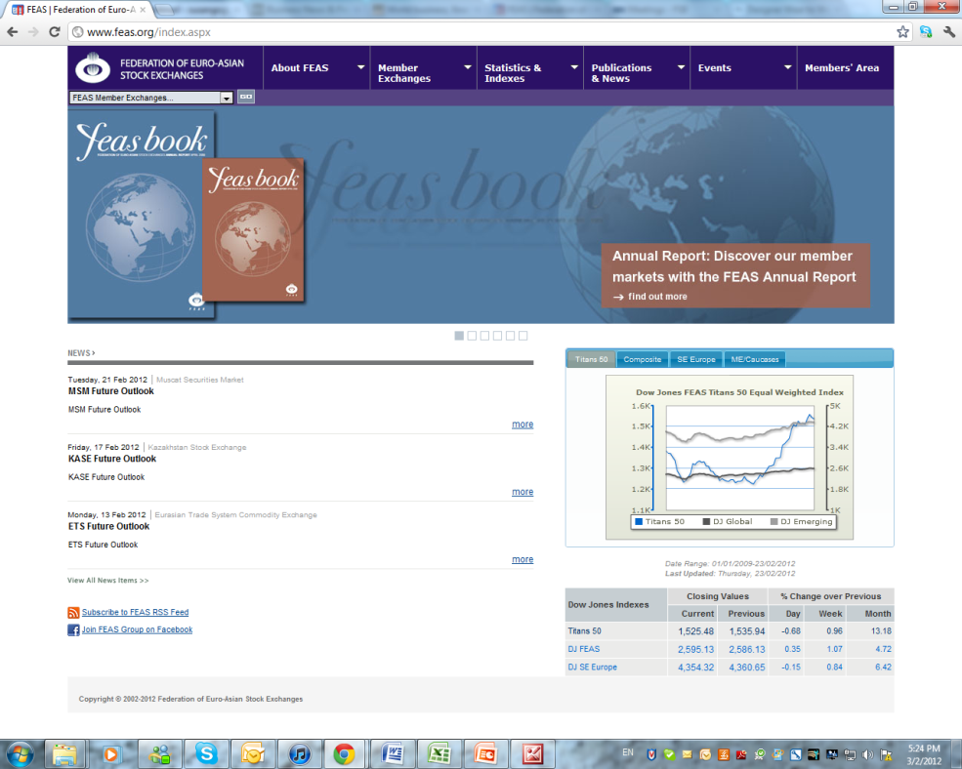
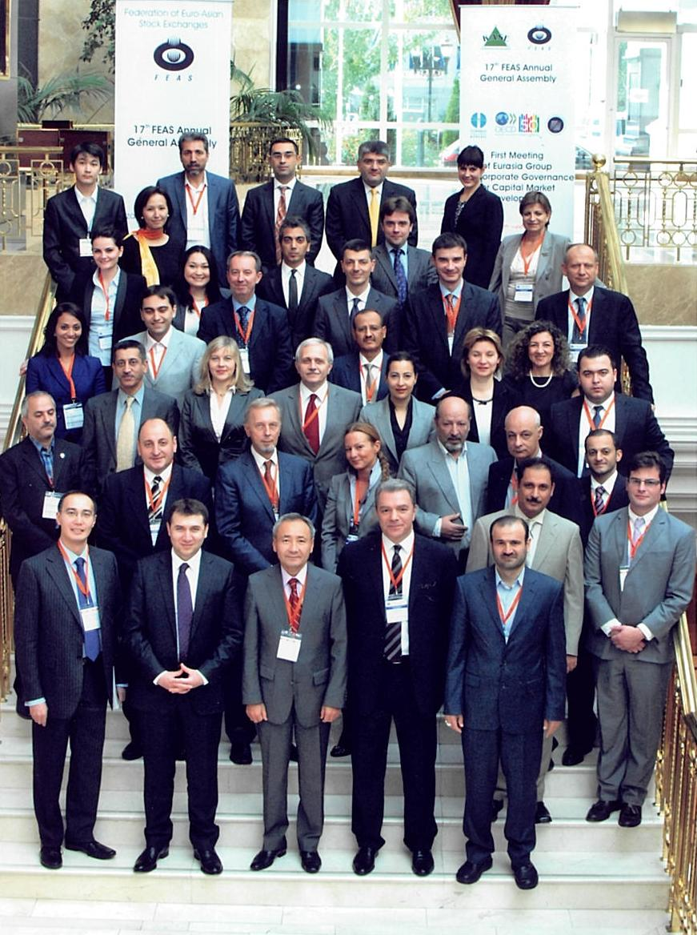
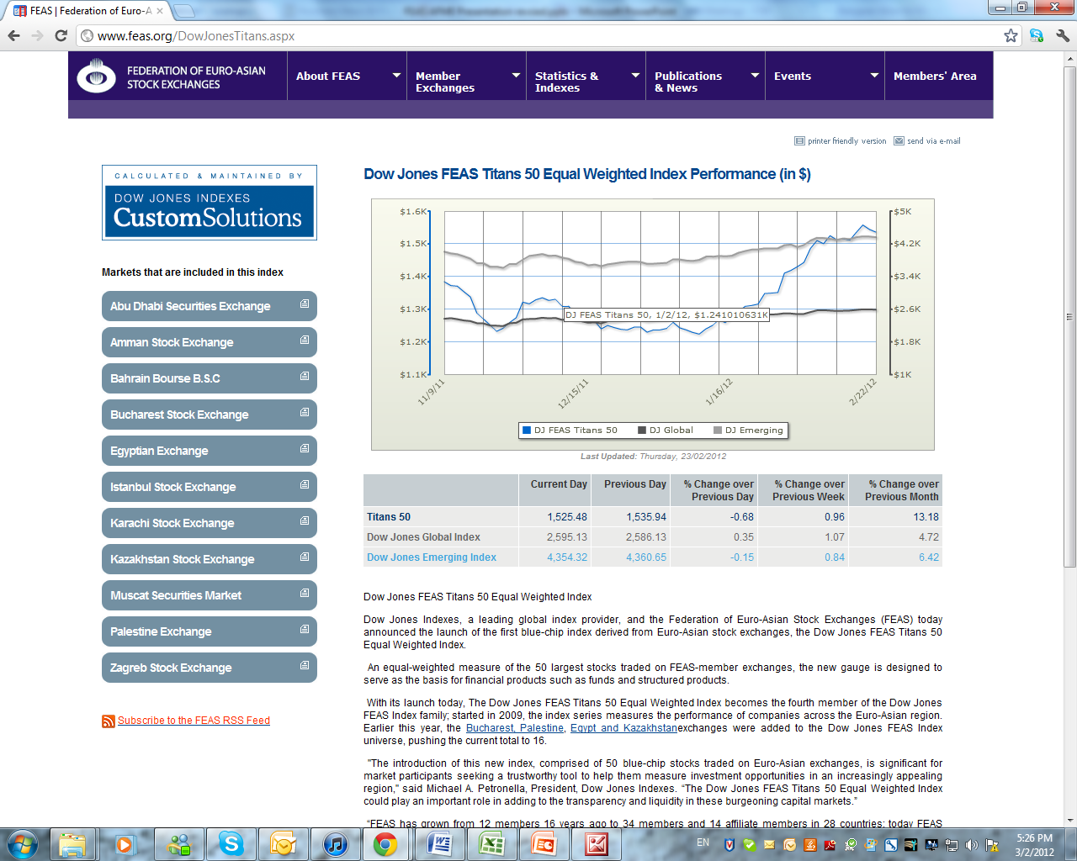

Slide 9
Dow Jones/FEAS Indexes
Dow Jones FEAS Composite Index.
Abu Dhabi (UAE), Almaty (Kazakhstan), Amman (Jordan), Banja Luka (Bosnia and Herzegovina), Belgrade (Serbia), Bucharest (Romania), Cairo (Egypt), Istanbul (Turkey), Karachi (Pakistan), Manama (Kingdom of Bahrain), Muscat (Oman), Nablus (Palestine), Sarajevo (Bosnia and Herzegovina), Skopje (Republic of Macedonia), Sofia (Bulgaria) and Zagreb (Croatia)
Sub regional Indices
South East Europe:
Banja Luka (Bosnia and Herzegovina), Belgrade (Serbia), Bucharest (Romania), Istanbul (Turkey), Sarajevo (Bosnia and Herzegovina), Skopje (Republic of Macedonia), Sofia (Bulgaria) and Zagreb (Croatia)
Middle East and Caucus
Abu Dhabi (UAE), Almaty (Kazakhstan), Amman (Jordan), Cairo (Egypt), Karachi (Pakistan), Manama (Kingdom of Bahrain), Muscat (Oman), Nablus (Palestine), and Zagreb (Croatia)
TITANS
Abu Dhabi (UAE), Almaty (Kazakhstan), Amman (Jordan), Banja Luka (Bosnia and Herzegovina), Belgrade (Serbia), Bucharest (Romania), Cairo (Egypt), Istanbul (Turkey), Karachi (Pakistan), Manama (Kingdom of Bahrain), Muscat (Oman), Nablus (Palestine), Sarajevo (Bosnia and Herzegovina), Skopje (Republic of Macedonia), Sofia (Bulgaria) and Zagreb (Croatia)

Slide 10
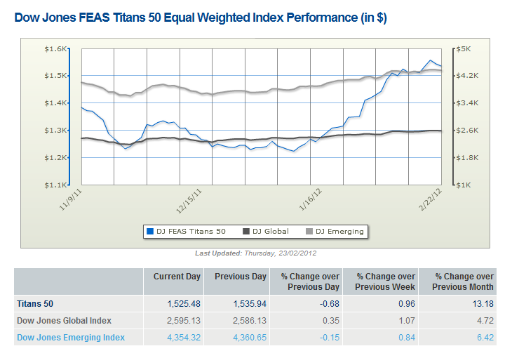

Slide 12
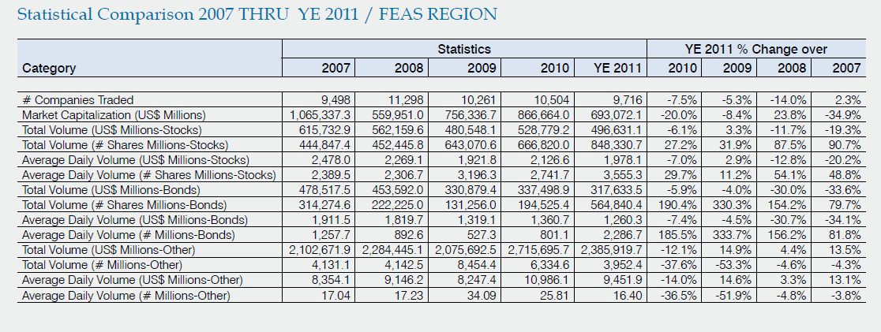
12

Slide 13
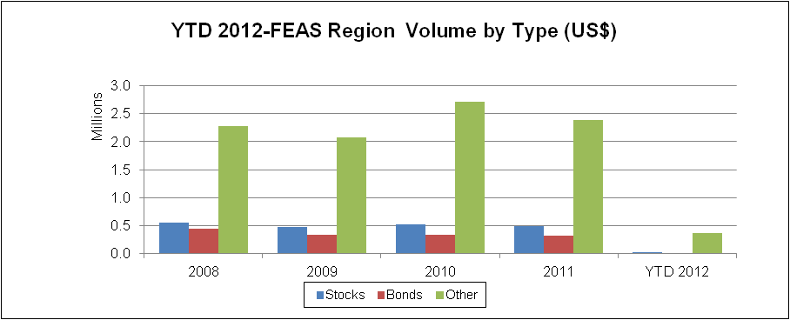
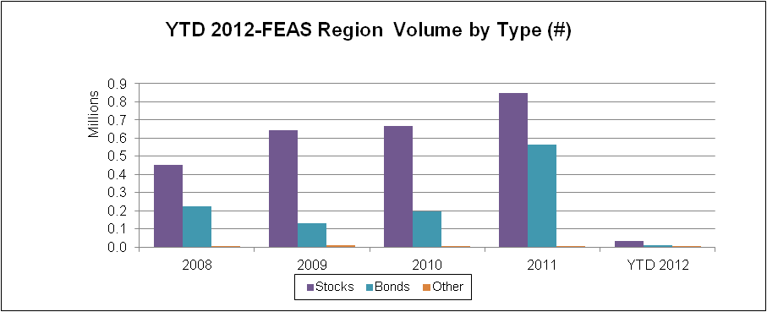

Slide 14
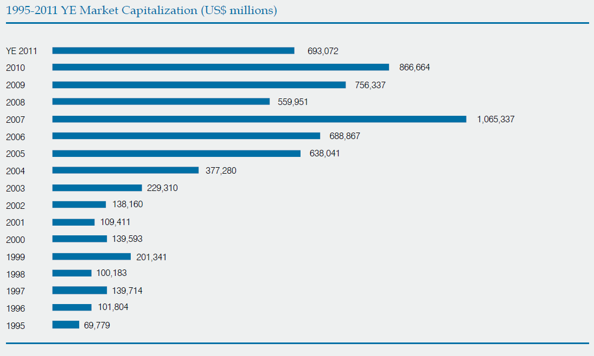
14

Slide 15
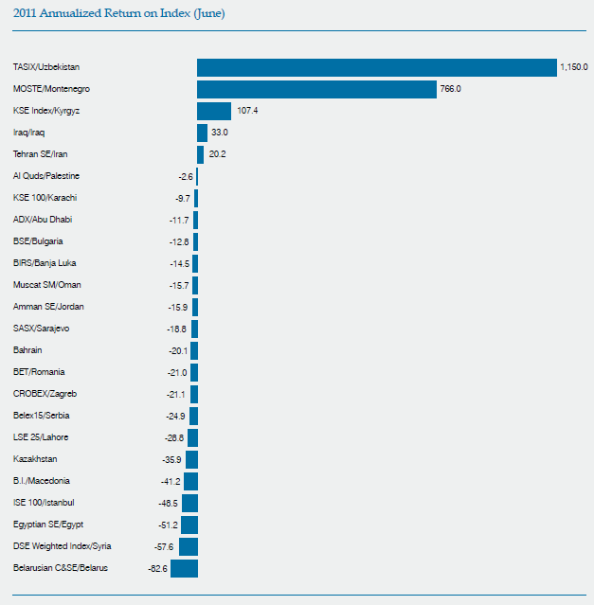

Slide 16
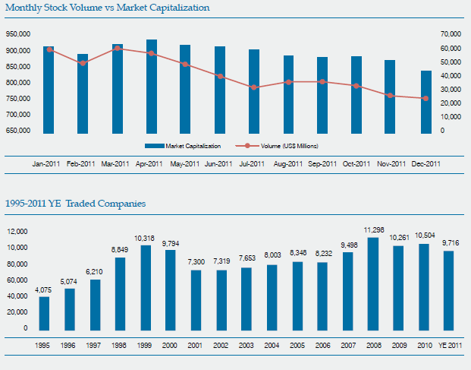

Slide 17
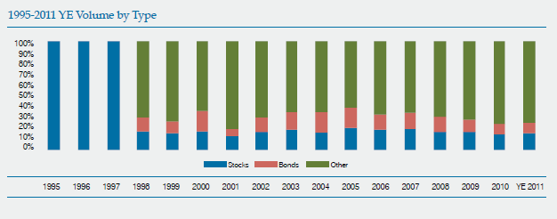

Slide 18
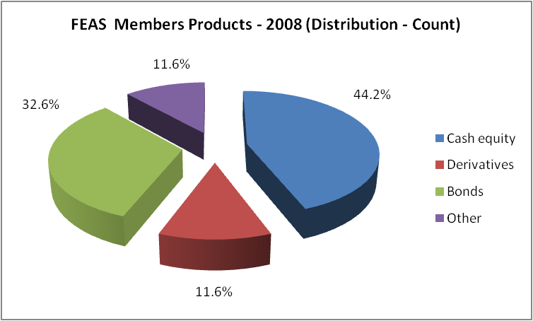
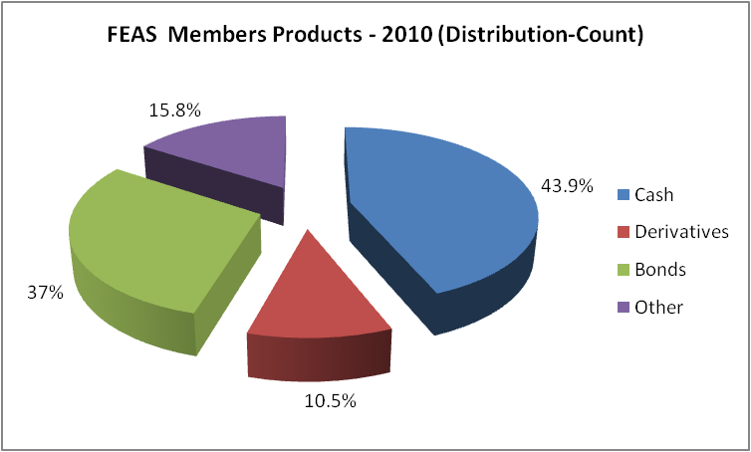
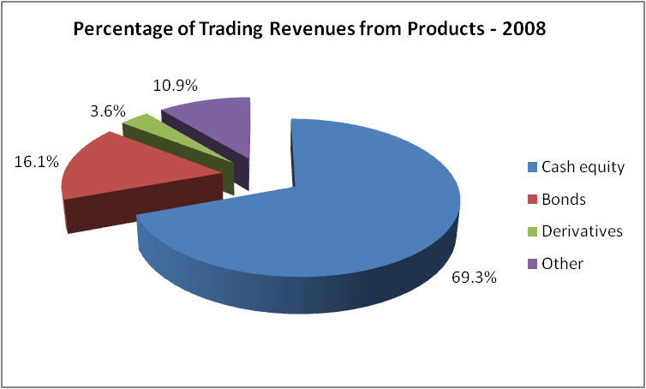
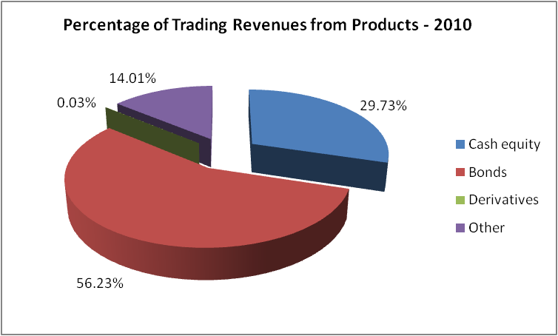

Slide 19
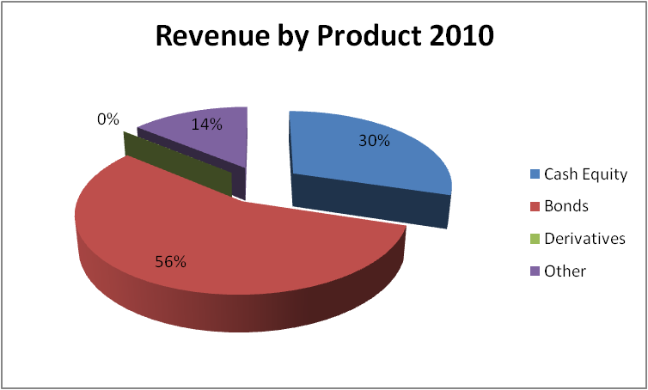
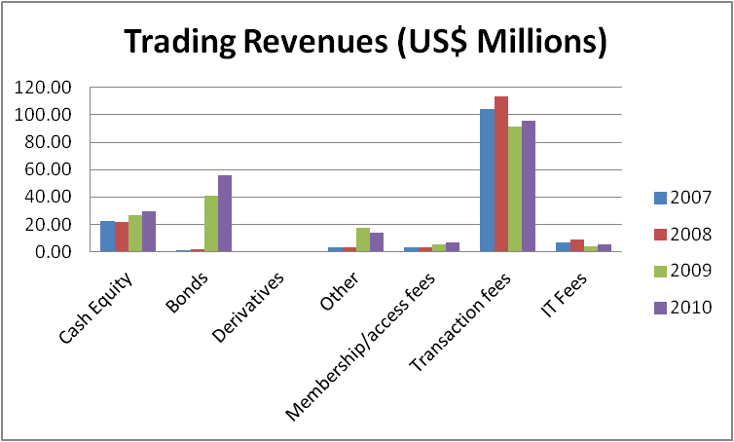

Slide 20
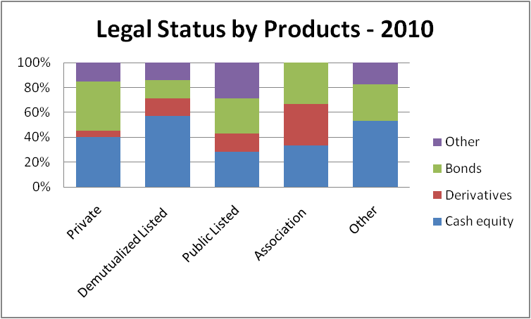

Slide 21
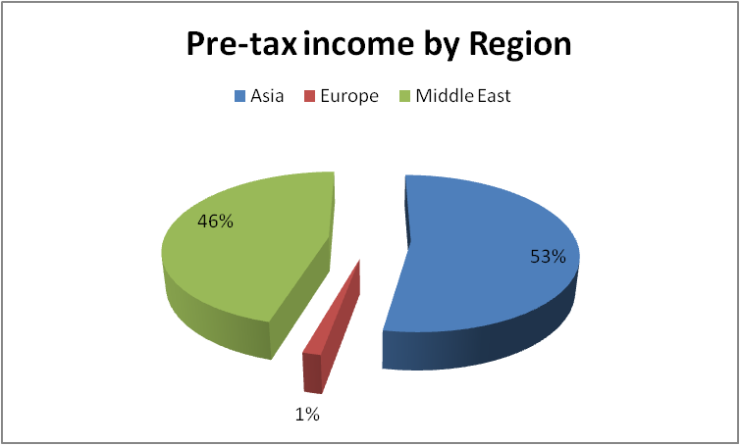

Slide 22
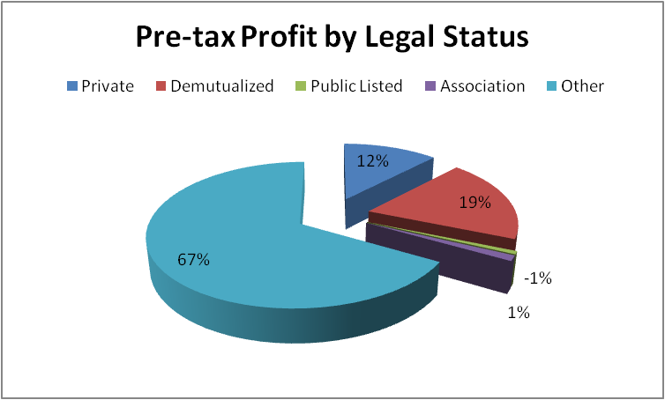

Slide 23
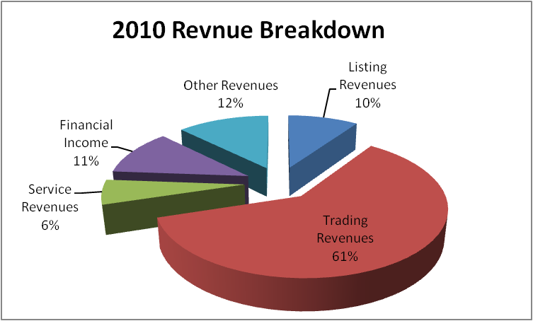
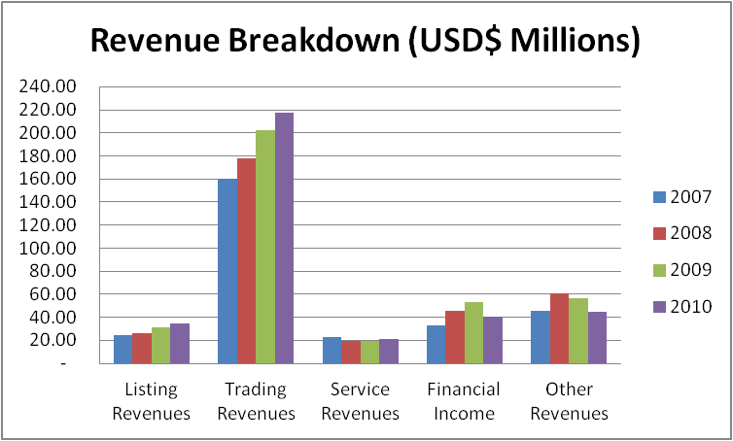

Slide 24
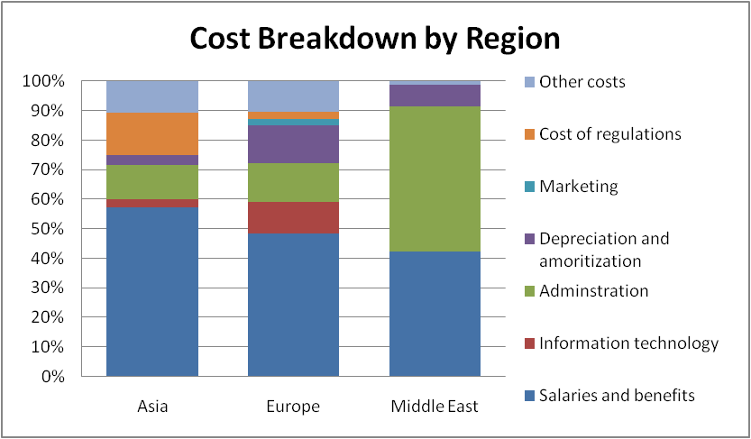
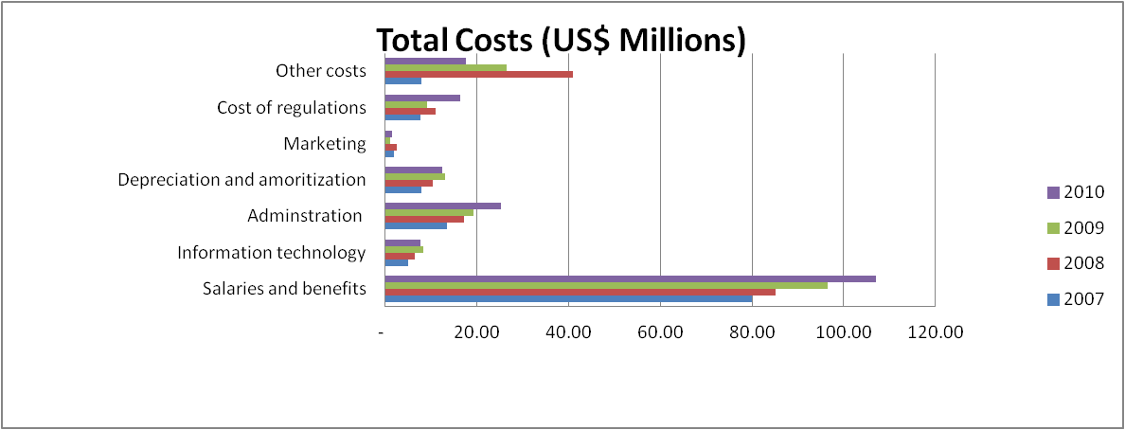

Slide 25
2012 Mandates
Expansion towards new memberships
Investment conference and exhibition in Istanbul
Publicity works
Rule book revisions
Focus on transparency and investor complaints
Mutual works and trainings towards derivative markets
Market linkages and connectivity

Slide 26
Thank you. Federation of Euro-Asian Stock Exchanges www.feas.org

