Slide 1
KSD’s Value Added Services
April 2012
Youngho Park
Managing Director
Korea Securities Depository

Slide 2






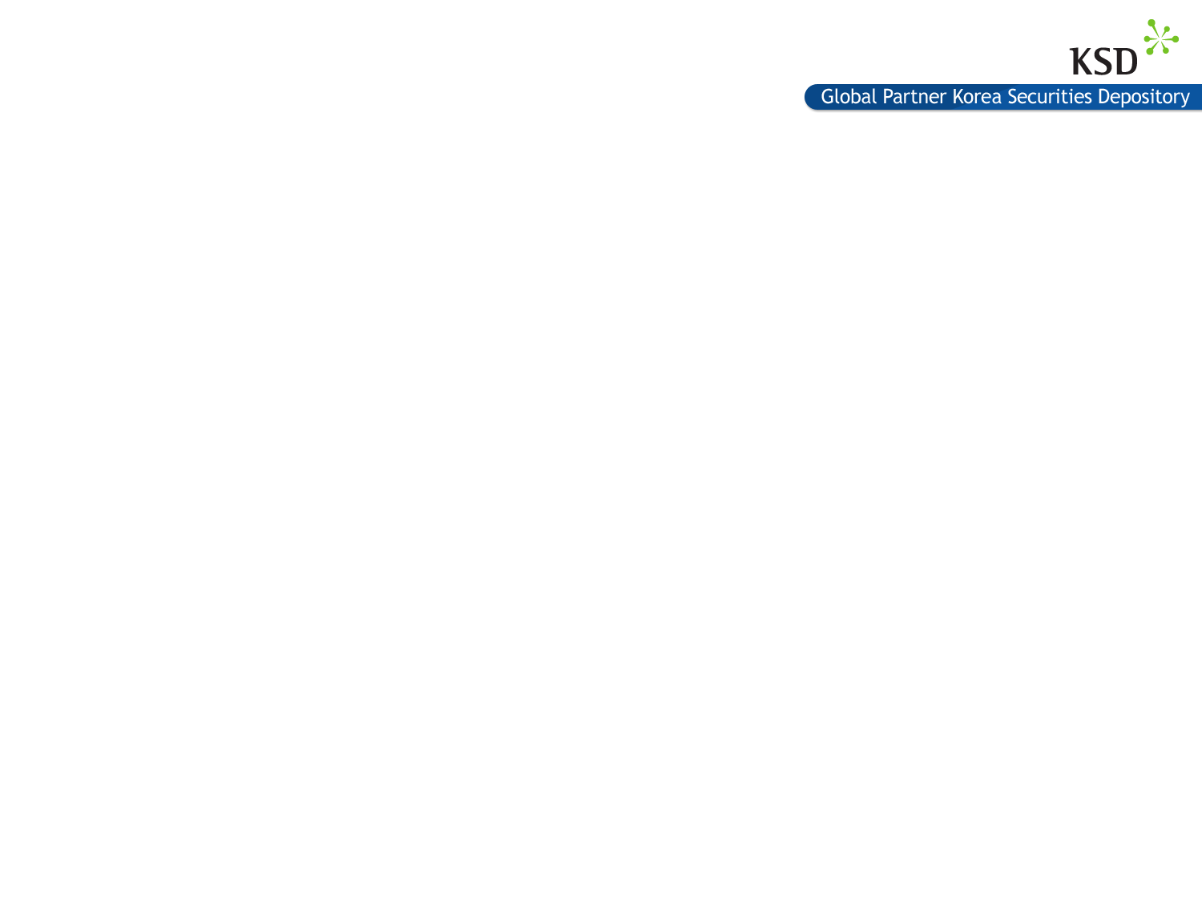

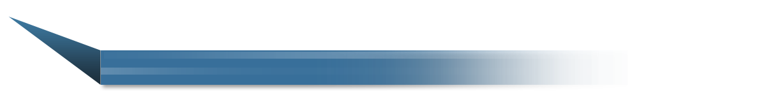

KSD Overview
Korea’s Only Central Securities Depositary KSD
Korea’s Only Central Securities Depository KSD
Established in 1974
Offers comprehensive securities services as a core infrastructure of the
Korean securities market
Asset management market services
Derivative market services
Cross-border clearing & settlement
Primary market support
Deposit & settlement of securities

Slide 3



Value Added Services
Various specialty services
as well as traditional services
Various specialty services
as well as traditional services
1974
Transfer agent service
Transfer
agent
1994
Cross-border clearing
& settlement service
Cross-border
clearing &
settlement
Securities
lending &
borrowing
1996
Securities lending
& borrowing
service
Tri-party
Repo
1999
Tri-party repo
service
FundNet
2004
FundNet service

Slide 4








KSD Centralized SLB System Process
Central securities depository (CSD) in the role of an SLB intermediary
1) Application
1) Application
Intermediary
(CSD)
2) Collateral
Intermediary
(CSD)
Borrower
3) Matching report
3) Matching report
Borrower
Lender
Lender
4) Credit(+)
4) Debit(-)
A/C book
(borrower)
A/C book
(borrower)
A/C book
(lender)
A/C book
(lender)
Central Deposit & Settlement System

Slide 5



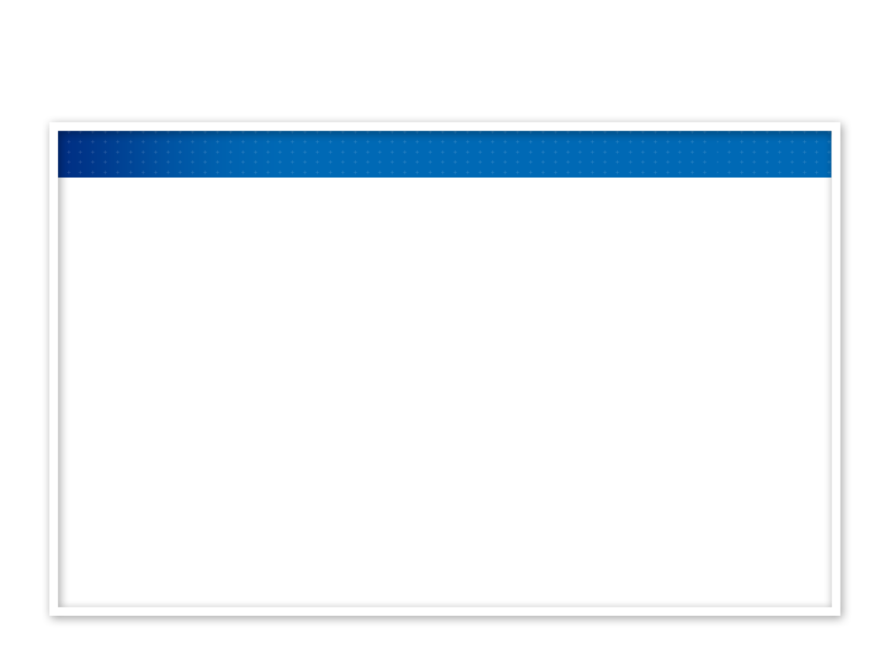
Advantages of KSD SLB System
Increased Efficiency by using the CSD System
- Saves time and cost of searching for available securities
- Enables effective decision from the price aspect
- Quick processing of large volume transactions
- Optimizes corporate actions administration
Safety of SLB Transactions
- Settlement guaranteed by the CSD SLB intermediary
- Collateral securities held at CSD account
- Daily marking to market of collateral securities
Efficient Market Monitoring
- Facilitates market monitoring through centralized data management

Slide 6

KSD’s Tri-Party Repo Services
Trade
Borrower
Borrower
Lender
Lender
Tri-party
Repo Agent
(CSD)
Tri-party
Repo Agent
(CSD)
Trade management
(Securities)
Trade management
(Cash)
Participant A/C Book
(Repo A/C)
Settlement
Trading
Collateral management
Rights management
Taxation

Slide 7


Advantages of KSD Tri-Party Repo Service
Fairness
Stability
· Offers repo services
as a third party
· Transactions managed
in a dedicated a repo account
· Risk reduced by DVP settlement
and marking to market
Tri-party
Repo Agent
(CSD)
Tri-party
Repo Agent
(CSD)
Convenience
Flexibility
· Offers same level of CA management
services as in the deposit system
· Allows customers to freely
decide transaction conditions
such as trade value, term
and repo rate
· Convenient tax management

Slide 8

KSD FundNet Service
The first case in the world a CSD established STP for the entire back-office
operations of the asset management market
CSD
Establishment & redemption system
Asset managing
company
Selling
company
Integrated trade confirmation system
Fund servicing
company
Broker
Management instruction delivery system
Trustee
Bank of Korea
DVP fund settlement system
Other
Overseas
custodian
Fund-by-fund deposit system

Slide 9
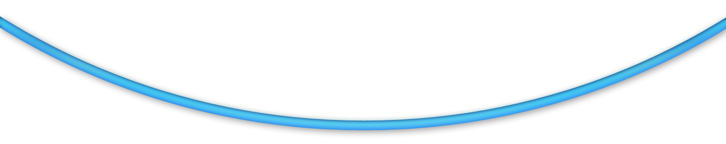



Effects of KSD FundNet
Efficiency and transparency ensured by
implementing STP for the asset management industry
Efficiency and transparency ensured by
implementing STP for the asset management industry
Securities company
CSD
Minimized
settlement risk
Asset management company
Trustee
Strengthened the role
of CSD as
a local STP platform
Enhanced timely monitoring & compliance functions
Reduced costs and operational/settlement risk

Slide 10

KSD Cross-border Clearing & Settlement System
One-stop service through the central deposit & settlement system
One-stop service through the central deposit & settlement system
Overseas
broker
Local investor
1) Application
2) Application
Overseas
broker
Local investor
Local broker
Local broker
Notice
3) Settlement
instruction
5) Payment
4) Settlement
instruction
Overseas
custodian
CSD
Overseas
custodian
CSD

Slide 11


Advantages of KSD Cross-border Clearing &
Settlement System
Convenience
Convenience
Customers can invest in overseas securities through the same processes
applied to domestic securities
Safety
Safety
CSD provides custody and management services for foreign currency
securities
Cost-competitiveness
Cost-competitiveness
Fees for overseas custodians are low due to economy of scale
Efficiency
Efficiency
Process standardization and automation is easily achieved

Slide 12


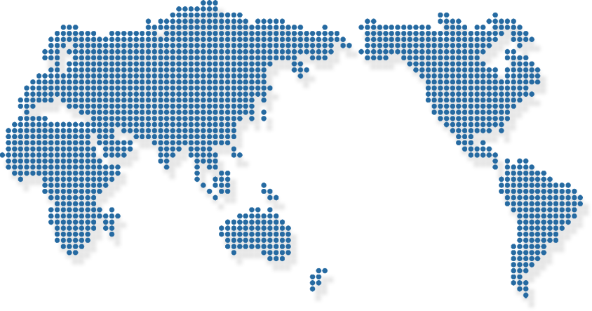
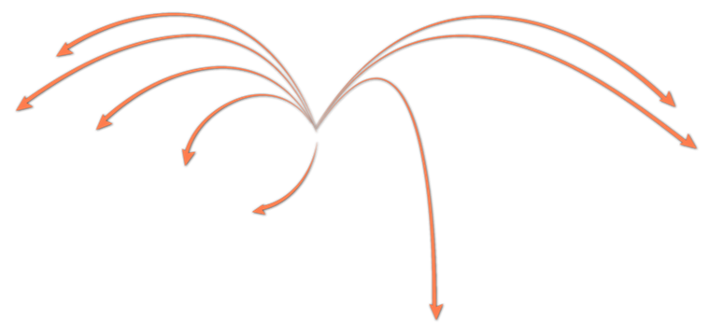

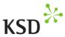

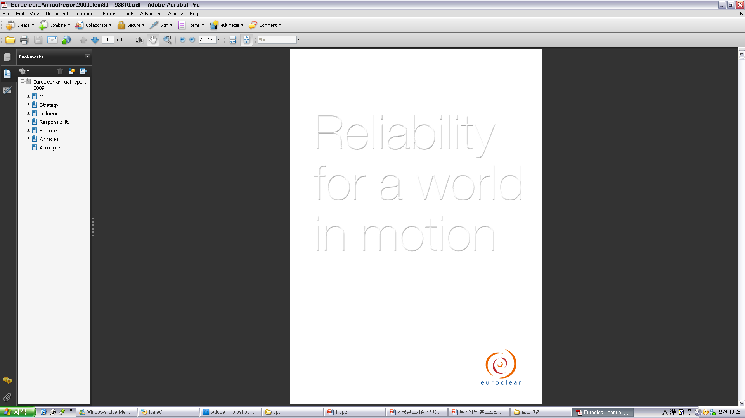
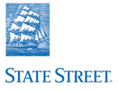

KSD Cross-border Clearing & Settlement Network
Overseas Network
Overseas Network
Standardization/Automation
Standardization/Automation
4 overseas custodians
4 overseas custodians
Processes international operations during local business hours
Processes international operations during local business hours
Network covers 36 overseas markets
Network covers
Provides a standardized business environment
Provides a standardized business environment
SAFE+
KSD’s on-line network
SWIFT
Luxemburg
Brussels, Belgium
NY, US
Boston, US
SWIFT
Society for World Interbank
Finance Telecommunication
Society for World Interbank
Finance Telecommunication

Slide 13


Transfer Agent Service
Protects shareholders’ rights and facilitates convenient rights exercise
Protects shareholders’ rights and facilitates convenient rights exercise
Reduces issuers’ costs and promotes market efficiency
Reduces issuers’ costs and promotes market efficiency
Offers useful policy instrument to securities supervisory authorities
Offers useful policy instrument to securities supervisory authorities
Deposit/safe custody
CSD
Entrust stock administration
Transfer
Agent
Issuing company
Stock Exchange
Public offering
administration
Management of total number of shares issued and capital
Stock administration consulting
Management of beneficial shareholder records

Slide 14
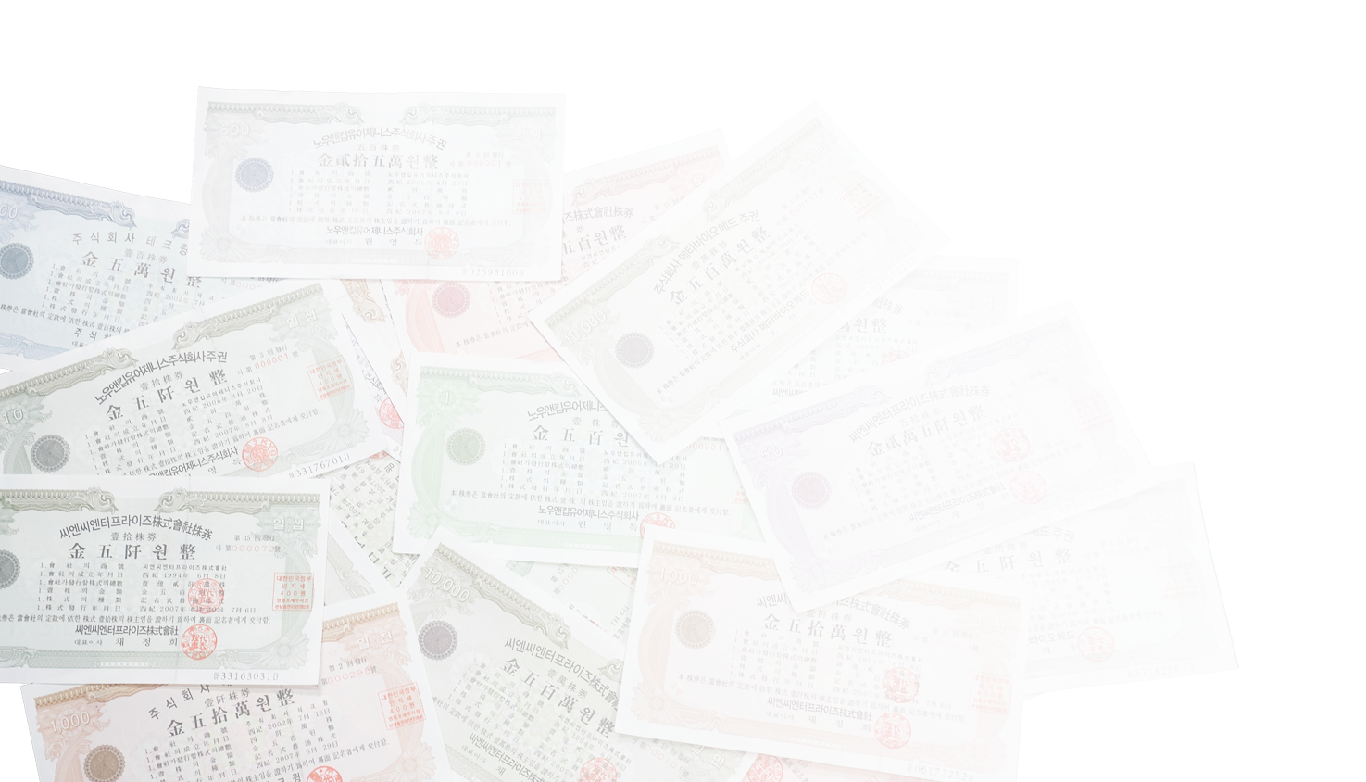



Effects of Transfer Agency Service Offered by KSD
Effective back- office service for the stock market
Effective back- office service for the stock market
Transfer Agent
Transfer Agent
Deposit system
Deposit system
Management of
shareholders' list
Deposit/safe-custody of securities
Management of beneficial shareholders, voting rights exercise
Transfer of title
Aligned process within CSD
Notification of shareholder rights
CA processing for overseas securities

Slide 15





Global Business Department
Korea Securities Depository
Phone : 82-2-3774-3357 Fax: 82-2-3774-3462
E-mail: minsoo@ksd.or.kr Homepage : www.ksd.or.kr

