Slide 1
Lending to SMES on the bases of movable collateral” Asset based lending and electronic factoring platforms
September 14, 2018
Eva Gutiérrez
Lead Financial Sector Specialist
Finance, Competitiveness and Innovation Global Practice

Slide 2
SMEs lack of real estate collateral hampers access to credit and secure transaction reforms (STR) help development of new SME lending products secured with movable assets
SMEs lack of real estate collateral hampers access to credit
Women owned SME’s are particularly credit constrained as they own less real state than men.
IFC supports reforms of secured transactions laws, collateral registries and enforcement mechanisms to optimize the use of movables as collateral (STCR reforms) in many countries around the world, including Uzbekistan

Slide 3
Suitable STR framework with the following characteristics
Allows for flexibility in the creation of a security right, so the obligation and the collateral can fluctuate. All tangible and intangible, present and future property can serve as collateral for a loan.
Clear and comprehensive scheme for determining the priorities of competing interests in movable property.
Quick and simple enforcement of the secured creditor’s rights in the event of a default by the debtor.
simple and effective means of publicizing interests in movables to facilitate assurance of a creditor’s priority (collateral registry).

Slide 4
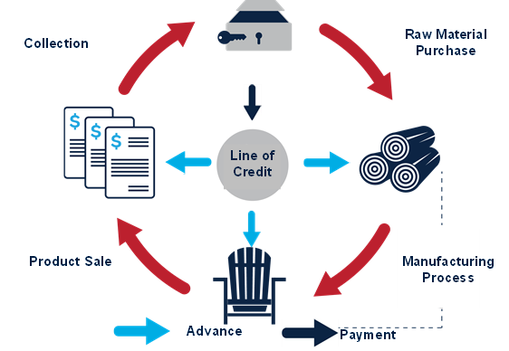
ABL: characteristics and benefits
ABL is a revolving, medium-term (3-5 years approx.) credit line, providing working capital to SMEs, mostly based on the value of their inventory (raw material and finished goods) and receivables.
Loan repayments are made when the customers of the SME pay the invoices for the goods received in a concentration account.
The lender performs a credit analysis of the SME with focus on the liquidation value of the available assets granted as collateral.
Through a Field Audit, lender determines the amount to advance to borrower based on available collateral, how the SME controls inventory and receivables and how this are reflected on financial statements. Collateral amount is updated periodically so the amount of funds available for withdrawal varies over time.
Benefits: Finances the whole production cycle of the firm (not only commercialization). Low default rates in their portfolios

Slide 5
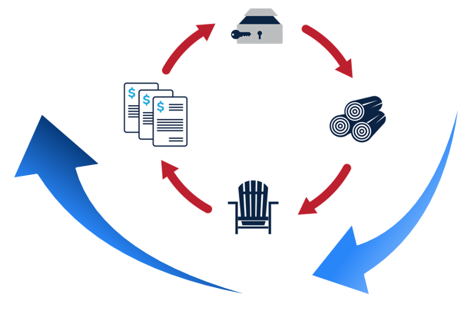
Value of Collateral = Credit Availability
Lower risk =
higher advance
Higher risk =
lower advance
+
+
=
Credit Line Availability
Eligible collateral
x
Advance rate (%)

Slide 6
Asset Based Lending Main Components
Financial Analysis
Collateral Liquidation Calculation
Inventory
A/Rs
+
+
Periodical Monitoring
+
=
ABL Credit Availability

Slide 7
Required Monitoring of an ABL Loan
Initially
Field Audit for Collateral
Every Draw Down
Updated Borrowing Base calculation
Monthly
Every 3 – 6 Months
New Field Audit
Accuracy of Ledger amounts
Outstanding +/- changes vs Past Balance + New Funding
Inventory and A/R levels
A/R supporting Info
Inventory Breakdown
Financial Statements (Balance and Income Statement)
Accuracy of Ledger Amounts
Differences
First Calculation of Borrowing Base (Credit Availability)
A/R Aging

Slide 8
Evolution of Factoring: The Case of Mexico Electronic Factoring Platform “Productive Chains Program”
BEFORE
AFTER

Slide 9
“Productive Chains “ Financial Factoring Operating Flow

Slide 10
Financial Factoring Operating Flow

Slide 11
Lending to SMES on the bases of movable collateral” Asset based lending and electronic factoring platforms
Thank You!

