Slide 1
IFC BANK Advisory Services
An Introduction
Tashkent
November 26, 2015

Slide 2
Why IFC provides Advisory Services to FIs?
High Market Demand/Opportunity
There is a huge demand for advisory
services
Women entrepreneurship only 12-15% in MENA,
less than half of global average
Entrepreneurs lack training & networking avenues
Improved Operations
FIs improve operational efficiencies
Giving ability to attract investors and funding, and
better able to use the additional funds. Key
weak area’s include:
  Institutional capacity in FCAS countries
  Risk management & CG practices
IFC FIG Advisory Services
Why provide Advisory Services?
Increased Outreach
FIs are able to sustainably and profitable
increase outreach to the un/under-served
MSME credit Gap(MENA) of US $ 250 Bn*
30-35% of SMEs remain excluded owing to
absence of Islamic banking
Improved performance of existing investment
clients
Improved governance and efficiency of
existing and potential investee FIs
* Mc kinsey MSME Finance database

Slide 3
An Integrated Set of Products and Services offered
Advisory Services
Our related Client Solutions
Strategy and business
Model design
Governance
Core Banking
Risk Management
Framework and tools
Credit framework process
reengineering
SME & Gender & Agri
Product development
And design
Sales & Marketing
Microfinance
Training FIs staff
Entrepreneurs Capacity
building
Sustainable Finance
Operations & Trade
IT improvement
FinTech
HR structures,
Incentives & rewards
Financial forecasting
and analytics

Slide 4
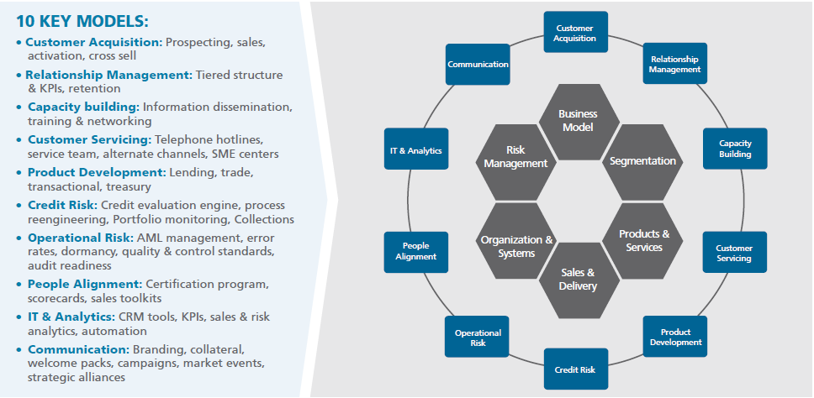
Capacity building is needed for banks to achieve sustained performance in the SME Banking business
Key areas where core competencies are required for successful SME banking
Source: IFC Analysis

Slide 5
Typical IFC advisory services engagement cycle
1
2
3
4
5
DIAGNOSE
STRATEGY
DESIGN & BUILD
PILOT & SCALE
IMPLMENTATION SUPPORT
Review key business & financial results
Assess current state
Needs assessment workshop
Identify opportunities
Detailed market and business analysis
Gap analysis & benchmarking
Develop strategy
Business model design
Project financial performance
Detailed design of solutions (e.g. credit, product, sales etc.)
Support approval of new solutions
Build tools and KPIs
Knowledge transfer
Pilot design
Marketing and communication plan
Define phases for achieving scale
Trouble shoot teething issues
Periodic reviews
Results Monitoring
Evaluating progress
Mentor/coach
Identify emerging trends
IFC Value Added Services
Tools
Knowledge
Global best practices
Innovations
Supply Chain Finance
Knowledge collateral
NFS Services
Supply chain tools
Wallet sizing tools
Benchmarking
Portfolio value analysis
Competency analysis
Workshop materials
Peer to Peer learning
Country/sector knowhow
Global experts
Check diagnostic
VSE Banking
Banking on Women
Technology solutions
Sustainable energy

Slide 6
An AS engagement involves a three stage process
Discovery
Design
Implementation
Stage 1
Stage 2
Stage 3
Module 4 -
Target Business Model Design
Strategy, Current State Assessment of the Business Model and the Credit process
Credit Reengineering
Risk Models & Infrastructure Design
SME Strategic Business Model Design
Customer Research & data mining
Product & Segment Proposition Development
Organisation & Channel requirements
(8 – 10 weeks)
(8-12 weeks)
(24 - 32 weeks)
Key
Major Milestone

Slide 7
Why partner with IFC?
In-House expertise
  As specialists, we use in-house deep technical skills and experience in designing and implementing business transformation programs
Tailored solutions with best practice experience
  We combine best practice models with tailored solutions that achieve high growth objectives for our clients through investment and advisory services
Access to key stakeholders
  Strong relationships with the government, private sector, real sector and financial institutions helping synergise efforts and enhance peer to peer learning
Global Footprint
  IFC is working with the best professionals across the globe to achieve the highest results for clients
Accelerated timeframe to get new designs mobilized
  Rapid completion to developing momentum combined with focused commitment of the client in terms of resource availability and necessary inputs

Slide 8




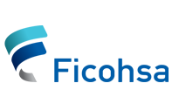






We are global specialists, with over 1,000 FI clients; 74 SME banking advisory projects across the world, strategic alliances with best practice banks and various SME banking advisory projects across MENA
AgroInvest
Bank
(Tajikistan)
Ceska Sporitelina
(Czech Republic)
Finterra
(Mexico)
CHUEE Energy Efficiency
(China)
Bank Muscat
(Oman)
Banco Atlantida
and Ficohsa
(Honduras)
Atlantic bank
(Belize)
FMB and NSB Bank
(Malawi)
Bank of St Lucia
(St Lucia)
Access Bank
(Nigeria)
Dewan (India)

Slide 9

















IV
Core Team and IFC Track Record
IFC’s track record in working with large financial banking institutions
(World)
(World)
(World)
(Slovenia)
(Czech Rep.)
(Lebanon)
(Mexico)
(Turkey)
(Barbados)
(India)
(Panama)
(Africa)
(Colombia)
(Bahrain)
(Africa)
(Cambodia)
Sudamericana (Holding)
(Argentina)
(Africa)
(Africa)
(Indonesia)

Slide 10







Selected Client Engagement Examples
SME Banking
Risk Management
SME Banking, SEF
Risk Management
SME Banking Unit Launch
Gender SME Banking
Gender SME Banking
Habib Bank
Banco Atlantida
Sogebank
Access Bank PLC
BLC Bank
Pakistan
Honduras
Haiti
Nigeria
Lebanon
Risk Management
Risk Management
Risk Management
Risk Management
Risk Management
La Nacional
Citizens Bank
VietinBank
Locko-Bank
BNK Bank
Dominican Republic
Guyana
Vietnam
Russian Federation
Ukraine

Slide 11
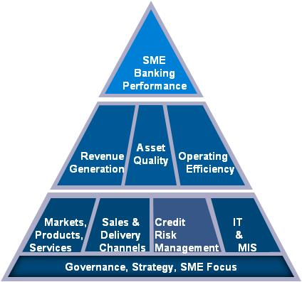
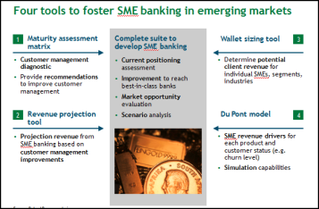
Innovation & Knowledge
SME Banking Knowledge Guide: Outlines leading practices and success factors for profitable SME banking operations. Guide has been translated into Arabic, Chinese, French, Russian and Spanish.
SME Banking CHECK Diagnostic Tool: A guide to assess SME banking operations and design relevant advisory services projects.
SME Banking Training Program: IFC offers two courses: An introduction or Scaling up course. The three day course consists of modules, case studies and exercises covering the following areas: business models for SME Banking, identifying Market Opportunities, Customer Management, Products & Services, Sales, Credit Risk Management, IT & MIS,
SME Banking Benchmarking: An online SME Benchmarking Survey, automatically benchmarks SME banking practices.
Market Segmentation Tool: Generates information that can be used by the Bank to make a decision whether to invest in developing its SME operations, identify target SME segments, and decide how to target them, design & sell products
Customer Management Best Practice Guide: The guide outlines key success factors in better serving the SME clients and allowing banks to maximize the revenue opportunity. It is primarily a technical publication, intended for bank directors and managers interested in acquiring the key capabilities to enhance growth and revenue, as well as building and retaining profitable customer relationships amidst ever-increasing competition for the SME segment.
Assessing & Mapping the Global Gap in SME Finance: A joint IFC & McKinsey report that assesses and maps the global gap in SME finance, including the number of enterprises by region, size and formality, as well as SME’s access to credit and value of the credit gap.
Customer Management Tools: provision of wallet sizing, du pont model and revenue projection models for the SME segment

Slide 12


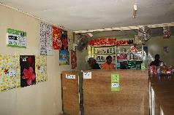
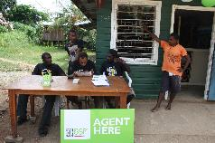

How Banks Can Leverage Digital Financial Services to Expand Outreach and Improve Efficiency
International Finance Corporation
World Bank Group
Tashkent – November 26, 2015

Slide 13
Agenda
DFS, what is it?
What is happening in Uzbekistan?
What are IFC’s current DFS actions in the country?

Slide 14
What is Digital Finance Services (DFS)?
DFS and Agency Banking together are a mechanism to allow Banks and/or other parties to use technology to access existing infrastructure to deliver superior banking services to customers off a lower cost base than traditional branch based banking.
This is both an opportunity and a threat to existing banks…

Slide 15
The range of Strategic Objectives served by Digital Financial Services are:
Strategy options
Defensive
Mobile enables new entrants – MNO’s
PSP’s
Many banks are looking at mobile
Expansion
Market share (existing markets)
New target markets
Geography
Secondary brands
Customer service
Convenience
Confidentiality
Cost containment
Opex (cost of branches, cost per transaction)
Cost Of Funds
Increasing Operational Efficiencies
For an FI considering DFS and or ADC: Prioritizing these overarching objectives is key to success

Slide 16

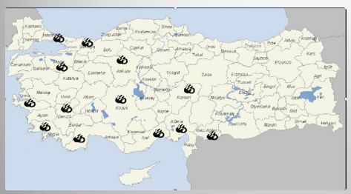

Expansion - Odea Bank: The New Entrant in Turkey
Odea Bank, owned by Audi Group in Lebanon, started operations in November 2012 and is pioneering a revolutionary tech-enabled means of banking. It’s branches are essentially self-operated kiosks, with ATMs, and video interface to speak with customer service representatives.
In the first year, they were selected as as “Turkey’s Most Innovative Bank” and “Turkey’s Best New Bank” by Global Banking and Finance Review.
In 2012, they were 40th out of 40 banks in Turkey.
As of 2015, they are at number 13 out of 40.

Slide 17
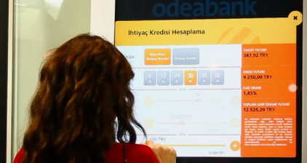
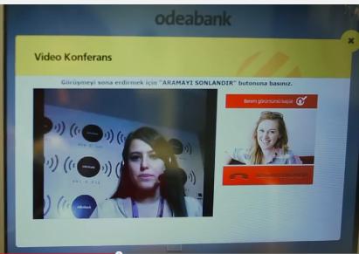
Odea Bank: Innovations
Some of the technology-enabled functions in Odea branches include:
      Mobile application to find nearby branches and get a customer queue number
      Smart billboards with ads for financial products outside their branches. These billboards have technology for recognizing the age and gender of the person standing in front of them and provide advertisements according to this information.
      Voice and video calls with contact center representatives who provide financial advice 24/7
      Touchscreen devices providing information, games, and other applications while clients wait
Odea Bank customer applying for a loan via video call

Slide 18
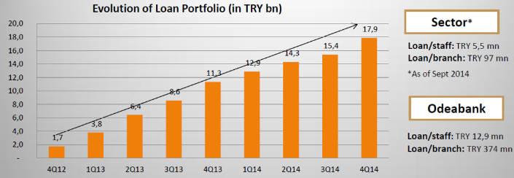
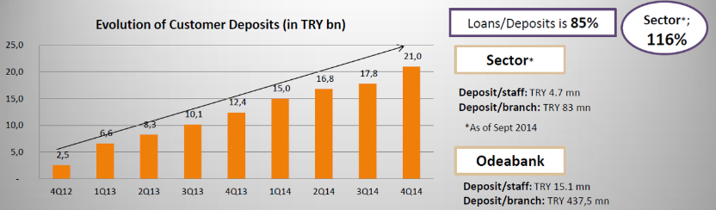
Odea Bank Has Registered Dramatic Growth as a Result of its Tech-enabled Strategy

Slide 19
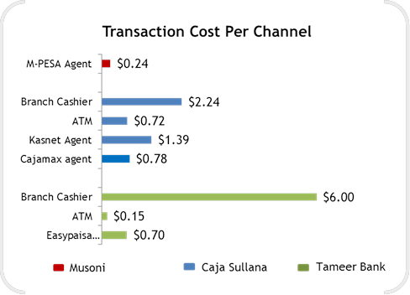
Cost savings by lowering transactional costs
MFI examples of costs
In House network transaction cost: 65% less than branch transactions
Outsourced network transaction cost: 38% less than branch transactions
mPESA agent
MFI
Branch cashier
ATM
Outsourced agent
Directly managed agent
MFB
Branch cashier
ATM
Agent Network
Set up and Maintenance Costs Comparison
Channel | Number of People | Set up Costs | Maintenance Costs/ Month (USD)
Branch | 10-15 | $70,000 | $5,000-$10,000
Satellite Point | 7-8 | $30,000-$45,000 | $3,000
Agent | 1 | $1,000-$2,000 | $200-$500

Slide 20
A whole new approach to credit – Big Data

Slide 21
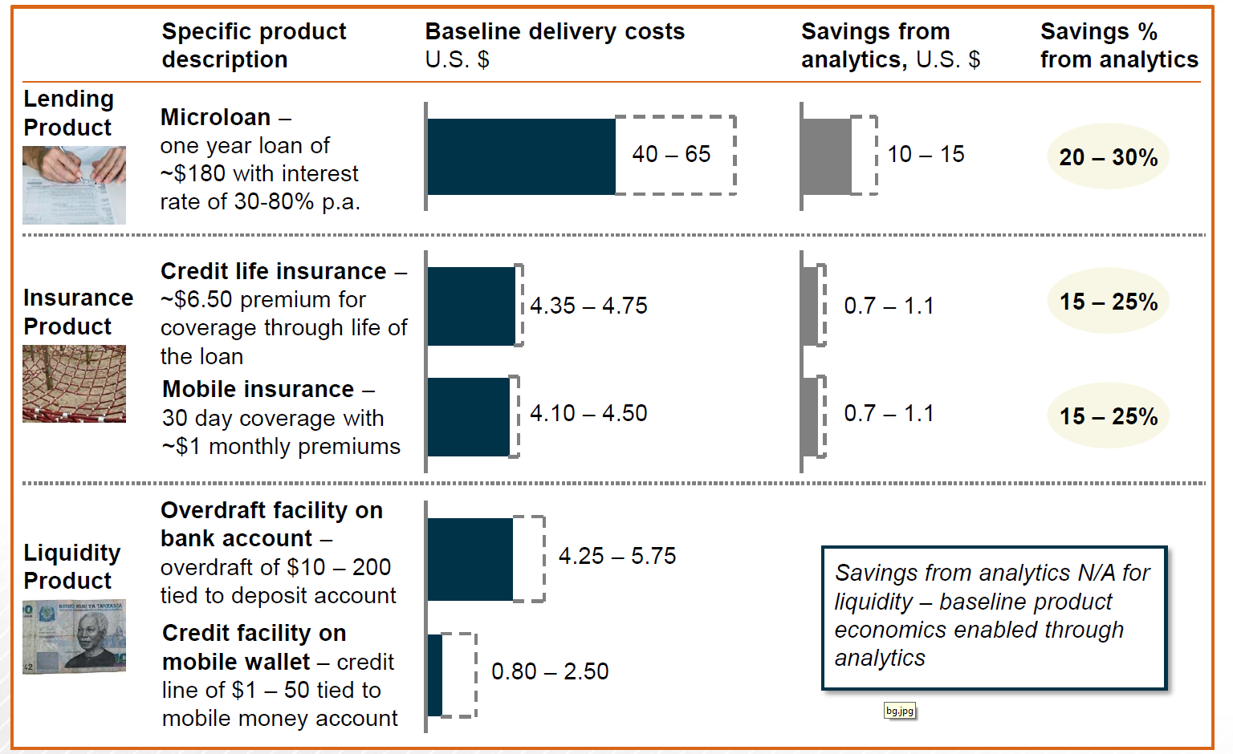
Data and advanced analytics can save between 15% and 30% of costs

Slide 22
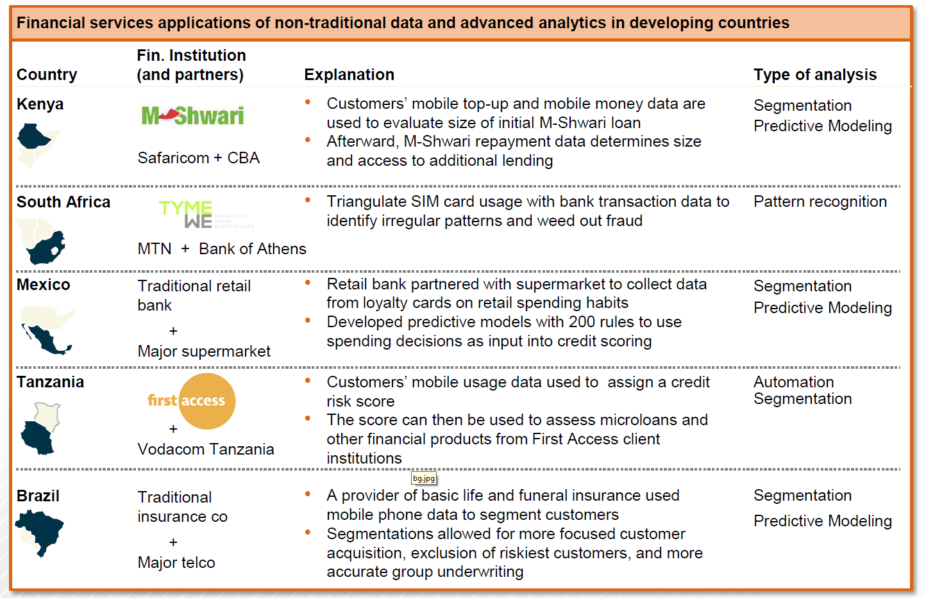
Who’s already using them?

Slide 23
Remember – DFS IS NOT about technology
It is a technologically enabled business proposition
There are many business options to choose from and this choice is driven by organizational strategy
There is technology available on the market to support (almost) any choice made by business
Agency Banking offers distribution but is not a panacea
Distribution is one of many tools to be considered as part of a specific overarching customer acquisition / service strategy
ADC’s often require doing deals with other parties, and, for these deals to make commercial sense requires a broader look at the total picture under review.

Slide 24
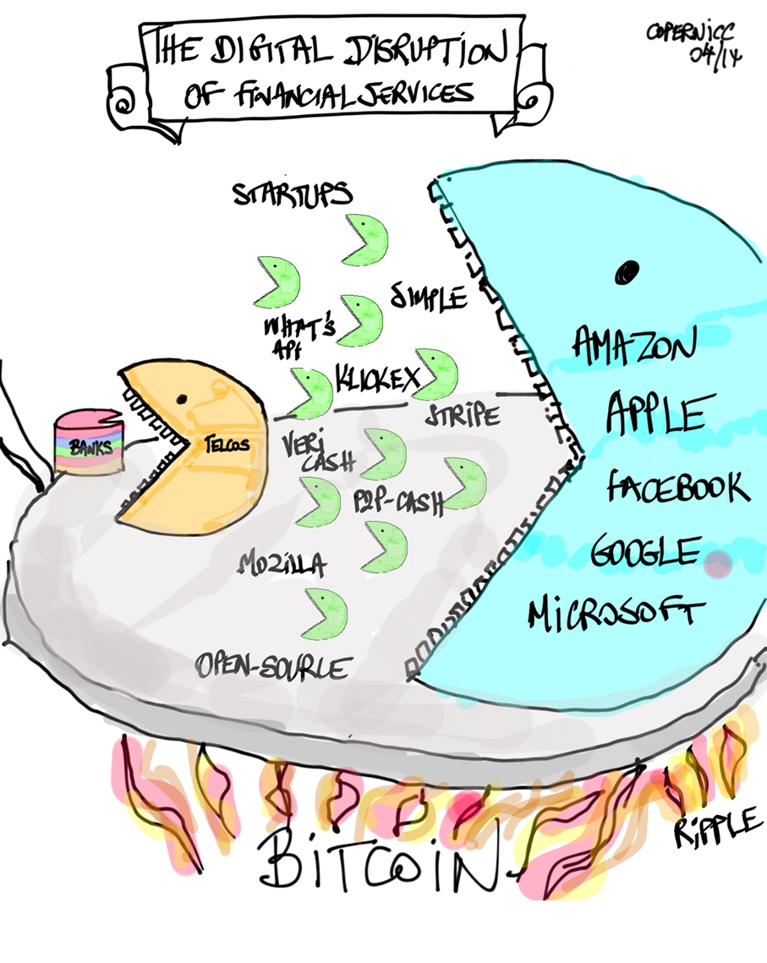
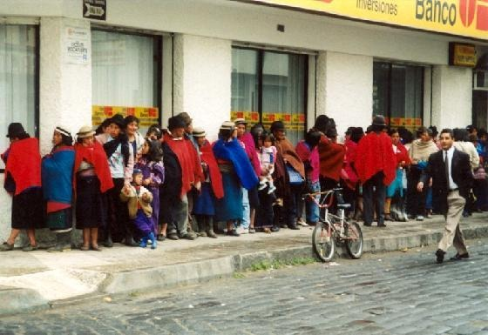
DFS – The Global Landscape
  Entry into the market by many non FI entities
  Our clients need to adapt to the changing environment or else lose market share.
  Advances in technology (data, analytics) have created alternative non traditional business models.
  Innovative financial products, channels, and technology provide significant opportunity to capture additional markets.
  New opportunities for IFC with new market entrants.
  New, tech savvy customers coming to the market – banking services need to move with the market
RETAILERS

Slide 25
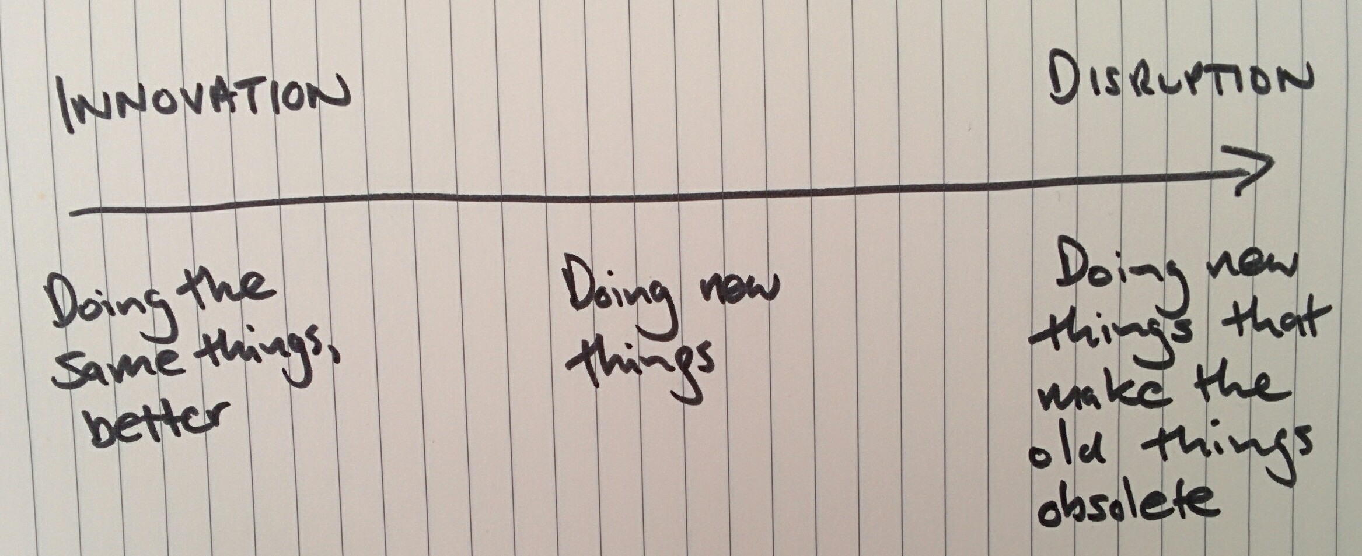

  Banks are currently focused on innovating their business models
  New and large market entrants (Retailers, MNOs) are mostly Doing new Things, but are also Disrupting a bit
  Fintech companies are disrupting financial services
  “It is only a matter of time before the sleeping giants of finance also enter new markets to disrupt the disrupters”

Slide 26
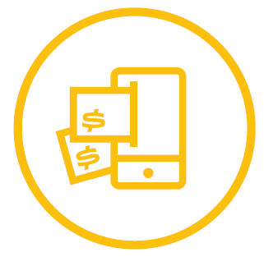
Digital Financial Services - ALREADY a Global Trend
Globally, about 50% of the population – 2.5 billion people – do not have a bank account. However, more than 75% has a mobile phone
Source: GSMA, The Mobile Economy, SSA, 2014; Global Findex Database 2014

Slide 27
STATE OF THE GLOBAL MOBILE MONEY INDUSTRY
255 MM services
255 services in 89 countries
300 million
Number of registered MM customers
2.3 million agents
In 75% of markets, MM agents outnumber bank branches (67 out 89 countries)
Available in 61% of emerging markets
In 25 markets, MM agents = 10 x number of brank branches
Number of markets where MM accounts outnumber bank accounts
16 countries
21 MM services
More than 1 million active accounts
Mobile money is one of the fastest growing forms of DFS and ADC.
There are more registered mobile money accounts than banks accounts in Cameroon, the Democratic Republic of the Congo, Gabon, Kenya, Madagascar, Tanzania, Uganda, Zambia, Zimbabwe, Burundi, Guinea, Lesotho, Paraguay, Rwanda, the Republic of the Congo and Swaziland.
Source:: GSMA State of the Industry 2014

Slide 28
The Uzbek DFS Market

Slide 29
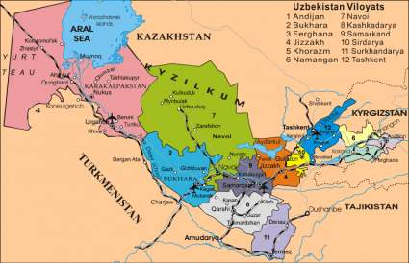
What makes Uzbekistan an interesting country for DFS?
POPULATION 31,2 million (2015)
ADULT POPULATION (15 to 65) 20.3 million (2015)
MOBILE PENETRATION 64 %
BANKED ADULT POPULATION 41% of adult population (8.3 mil people)
UNBANKED ADULT POPULATION 59% (11.9 million people)
% ADULTS UNDER POVERTY LINE 17% (3.5 million people)
BANKABLE BUT UNBANKED 8.4 Million People
For a pure DFS operation to break even month to month, based purely on Service Fee income it needs to attract ~1.5 mil customers of which 10% must be active each month.
Potential scope for suppliers to enter an underserviced but economically viable business

Slide 30
MOBILE MONEY IMPLEMENTATIONS
  CLICK – USSD based connectivity. a system of mobile banking that allows individuals to make payments via mobile phone (via USSD \ SMS-portal) or the Internet (via Web \ Web-mobile) for the services of mobile operators, internet providers; transfer funds to other individuals, trade and service companies (buying in supermarkets, payment in restaurants and theaters); make online purchases from online stores directly from a bank account.
  SMSTOLOV - SMS based connectivity. The national electronic payment service SMS-TO'LOV was developed in order to implement the Law of the Republic of Uzbekistan "On electronic payments" to promote the development of e-commerce. SMS-TO'LOV advantage is the possibility of non-cash payments through any mobile communications or the Internet, as well as through SMS-messages.
  PAYNET - Company operates in the market of Uzbekistan since 2005. During this period, it has connected more than 100 providers of various services, among them the utilities, which can be paid in any of the 25 000 points of payment receipt in the country.

Slide 31
IFC’s next steps in Uzbekistan
Support extension of the access to financial services through DFS development in Uzbekistan
  Conduct a country wide scoping of DFS
    Banks
    Mobile Network Operators
    Switches
    Mobile Money service providers
    Payment Service providers
  Partner with select banks to provide:
    Advisory Services, and/or
    Investment Services

Slide 32
IFC Advisory Services Areas of Expertise
DIAGNOSTIC AND Business MODELLING
Develop and monitor the business case and business plan for DFS operations
Network Build-out
Support agent network build out by assessing money flows & training agents.
Product and Process Design
Conduct client needs assessment to develop product & process design.
Customer Up-take and Financial Awareness
Develop financial awareness campaign to ensure customer uptake and education.

Slide 33
IFC Investment Products: Examples of Where They Have Been Used for DFS
LOANS
A Bank: Senior loan to expand via agent banking in rural areas
An NBFI: Debt in local currency to remove forex risk
EQUITY
An NBFI: Strengthening the balance sheet of the holding company to fully support subsidiaries
An MFI considering expansion via ADC
SYNDICATIONS
Although conceptually doable, there is no project that’s big enough yet.
RISK SHARING / GUARANTEES
A Bank: Potential for risk share to lend money to low-income segments

Slide 34









Example of IFC’s DFS Portfolio - IS & AS
$7,300,000
Equity, Quasi-Equity and Follow-on equity
Advice to expand product suite: insurance, remittances, insurance, & savings
(INDIA)
$250,000,000
Guarantee Facility
(GLOBAL)
Developing rural mobile financial services to improve financial inclusion in PNG.
(Papua New Guinea)
$5,000,000
Equity in mobile payment JV
Advice to conduct customer behavior study & education and agent training
(BANGLADESH)
Advice to develop mobile financial services to increase outreach in rural areas
(MADAGASCAR)
Advice to pilot agent network expansion and new pre-paid cards to lower-income client base
(HAITI)
Advice to design a mobile financial services business strategy for products and alternative distribution channels.
(COLOMBIA)
Advice to launch mobile solutions for MSMEs to increase outreach and working capital loans
(BRAZIL)
Advice to launch mobile solutions including agent network build-out and management
(RWANDA)
Alibaba Group affiliate
RMB 500,000,000
Senior loan
the first internet-based gender-finance program in China.
(CHINA)

Slide 35
Q & A

