Slide 1
Observed trends in the payment industry
Tashkent, 2015

Slide 2
The global provider of secure financial messaging services
Notes:
About SWIFT
What is SWIFT? SWIFT is a secure global carrier of financial messages. SWIFT enables users worldwide to exchange automated, standardised financial information securely and reliably. It is a member-owned cooperative through which the financial world conducts its business operations with certainty and confidence.
SWIFT is not a profit maximiser, but it is commercial; as a utility, it is operated for the benefit of its users.
SWIFT is headquartered in Belgium
SWIFT’s services include:
Messaging: SWIFT provides a variety of different services to exchange messages and files.
Connectivity: SWIFT provides access to a trusted network of users worldwide.
Access: SWIFT offers a variety of methods to connect to our proprietary network.
Standards: SWIFT collaborates with the user community to standardise messages types.
Applications: SWIFT offers additional business applications and services:
SWIFT also brings the global financial community together to work collaboratively to shape market practice, define messaging standards and debate issues of mutual interest with a view to developing collaborative solutions.
SWIFT - Is not a bank
Does not hold funds
Does not store financial information

Slide 3
SWIFT Overview SWIFT is an industry owned, not-for-profit, utility
1978
First Sibos
1976
First Operating Center opens
1980
Asia
1987
Securities
1994
Hong Kong
2001
SWIFTNet live
2006
Corporates
2012
Sanctions Services
1970s
1980s
1990s
2000s
2010s
1973 SWIFT founded
1979 North America
1986 Value-Added services
1996
Volumes exceed 3M messages/day
2004 SWIFTNet migration complete
ISO 20022 introduced
2004 Switzerland OPC
Corporate services centre in Kuala Lumpur
1977
SWIFT goes live

Slide 4
Oversight Group Co-operating Central Banks of G10 countries
Belgium
Canada
France
Germany
Italy
Japan
The Netherlands
United Kingdom
United States
Switzerland
Sweden
ECB
Extended oversight
Australia
China
Hong Kong
India
Korea
Russia
Saudi Arabia
Singapore
South Africa
Turkey
Notes:
OVERSIGHT
As a strategic global financial market infrastructure SWIFT maintains an open and constructive dialogue with regulatory authorities. Because of SWIFT’s crucial importance for the safety and efficiency of payment and securities settlement systems, SWIFT is directly overseen by the G-10 Central Banks. This oversight is under the lead of the National Bank of Belgium (NBB) since SWIFT is domiciled and headquartered in Belgium.
The Central Banks of the G10 include the: Bank of Canada, Deutsche Bundesbank, European Central Bank, Banque de France, Banca d’Italia, Bank of Japan, De Nederlandsche Bank, Sveriges Riksbank, Swiss National Bank, Bank of England and the US Federal Reserve System.
In 2012, SWIFT oversight arrangements were expanded with the establishment of the SWIFT Oversight Forum. In the Forum, senior representatives of the G10 jointly with ten other central banks conduct discussions on the SWIFT oversight policy and results. These additional central banks include:
The Reserve Bank of Australia, People’s Bank of China, Hong Kong Monetary Authority, Reserve Bank of India, Bank of Korea, Bank of Russia, Saudi Arabian Monetary Agency, Monetary Authority of Singapore, South African Reserve Bank and The Central Bank of the Republic of Turkey.
The major risk category under review by the Overseers is operational risk.
The Overseers have translated their focus on SWIFT’s management of operational risk into the drafting of five High Level Expectations. (HLEs).
The HLEs centre around SWIFT’s security (confidentiality, integrity, availability) and system resilience, and set out expectations for: risk identification and management, information security, reliability and resilience, technology planning, and communication with users.
The HLEs constitute the framework for reviewing SWIFT activities that fall within the scope of the Oversight.

Slide 5
Governance
Board of Directors
Banking & Payments Committee
Securities Steering
Committee
Technology &
Production
Committee
Audit & Finance
Committee
Human Resources
Committee
Franchise Risk Committee
Community input
SWIFT Groups
Notes:
Governance, Oversight and User Representation are key to SWIFT’s success.
SWIFT’s Board is composed of 25 members from up to 19 different countries, representing the geographical spread of our Community of users.
The Board has six Board committees.
The main mission of these Committees is to assist the Board in the execution of its governance responsibilities. They advise the Board on strategic and policy matters and make recommendations to the Board.
The Board Committees are: Audit & Finance, Franchise Risk Committee, Banking & Payments, Human Resources, Securities, and Technology & Production.
The Chairmen of the Committees together form the Chairmens’ Committee.
The members of the Committees are appointed by the Board of Directors.
Each Committee has its own terms of reference that are approved by the full Board.
The Chief Auditor has a dual reporting line with a direct functional reporting line to the Chair of the AFC and a direct administrative reporting line to the CEO. The CRO reports directly to the CEO.
SWIFT periodically creates special SWIFT Groups (Advisory Groups and Task Forces) to assist the Board or Board Committees on detailed industry matters – for instance, the Sanctions Advisory Group supports the Board in formulating and scoping SWIFT strategy and business development plans for standards, policies and shared services linked to sanctions compliance and related topics.
Such SWIFT Groups are composed of experts in the related matters and are usually operate for a limited period of time.

Slide 6
SWIFT users
Banks
Fund Managers
Central Counterparties
Clearing & Settlement Systems
Corporates
Broker-Dealers
ICSDs
Central Banks
Global Custodians
CSDs
Stock Exchanges
Depositories
Trade Depositories
Notes:
Who are our Users?
SWIFT’s trusted network connects a wide range of financial users across the globe, enabling them to securely exchange proprietary data.
We offer connectivity, whilst assuring data confidentiality and integrity.
We aim to lower cost, reduce operational risk and eliminate operational inefficiencies for our users.
Across the world, our users trust us every day to exchange over 22.3 million FIN messages on average – or more than 5.6 billion FIN messages each year.

Slide 7
SWIFT in figures
25.8 million
FIN messages peak day (2014)
5.6+billion
11%
FIN messages per year (2014)
Increase in FIN traffic (2014)
10,800+
200+
SWIFT users
Countries and territories
Notes:
SWIFT in figures:
SWIFT provides the platform, products and services that allow more than 10,800 financial and securities institutions and corporate customers in over 200 countries and territories to communicate with each other securely and reliably.
Three state-of-the art and interconnected data centres manage SWIFT’s proprietary secure financial messaging service.
Over 24 offices worldwide provide direct support to customers; certified industry partners and service bureau also provide third-party services to customers.
SWIFT is owned by over 3000 banks in proportion to their usage
In 2014 SWIFT processed over 5.6 billion FIN messages – an average of 22.3 million FIN messages per day; our FIN Traffic grew by over 11 percent, and we had a peak day of 25.8 million (FIN) messages.
During 2014 we experienced an exceptional number of peak days in Securities messages – with 9 peak days during the year. The last peak was on December 18th, when 11.5 million Securities messages went through the system.
We also had two peak days in Payment messages – the latest on Sept 30th, when 13.2 million messages went through the system.

Slide 8
SWIFT Overview Core functions are the platform, messaging & standards …
Secure Platform
SWIFTNet is SWIFT’s advanced IP-based core messaging platform
Secure - Platform delivers the security, reliability and availability required to support the growing volume of messages on our network
Secure Platform
Messaging:
FIN - SWIFT’s core store-and-forward messaging service
InterAct - enables the interactive real-time and store-and-forward exchange of messages
FileAct - enables customers to exchange files
Standards
‘Registration Authority’, overseeing the annual maintenance for various standards
Standards
Messaging
Registration Authority
ISO 9362 BIC codes
ISO 10383 Market MIC codes
ISO 13616 IBAN
ISO 15022 Financial Messaging
ISO 17442 Legal Entity Identifier
ISO 20022 Financial Messaging

Slide 9
SWIFT Overview … supporting comprehensive products and services …
SWIFTRef
Identifiers – national bank codes, IBAN, SEPA, BICs
Payments SSIs
MyStandards
Readiness Portal
Standards
Tools
Reference
Data
Financial Crime Compliance
Sanctions Screening
Sanctions Testing
KYC Registry
Compliance Analytics
Intraday liquidity offerings
Monitoring, reporting and industry best practices
Liquidity
Tools
Secure Platform
Compliance
Services
Standards
Messaging
Business
Intelligence
Interfaces
& Integration
Analyser – Volume / Value / Billing
Watch Insights reports
SWIFTScope
SWIFT Economics - RMB Tracker / SWIFT Index
Interfaces - AMH, SAA, Lite 2
Integration - IPLA, Converter
Resiliency
Tools
Services
Consulting
Training
Customer Support
Resiliency
MIRS

Slide 10
SWIFT Overview … serving distinct business domains …
Securities
Securities
Allocation, Confirm and Affirmation
Settlement
Reporting
Collateral Management
Asset Servicing
Payments
Payments
Customer Payments
Institutional Payments
Cash Management
Standards
Tools
Reference
Data
Liquidity
Tools
Secure Platform
Compliance
Services
Standards
Messaging
Business
Intelligence
Interfaces
& Integration
Trade
Letters of Credit
Open Account BPO
TSU
Collections
Resiliency
Tools
Treasury
Foreign Exchange
Money Markets
Derivatives
Services
Trade
Treasury
Notes:
TSU= Transaction Service Utility (confirmation sell/buy – agreement on price for example)
BPO = Bank Payment Obligation (//lettre de crédit)

Slide 11
SWIFT Overview … supporting 10,800+ clients, including HVPs
Banks
Custodians
Payment
Service
Providers
Payments
Securities
MIs
HVPs
Corporates
MIs
CCPs/CSDs
LVP/RTP
Trade
Treasury
Investment
Managers
& Funds
Broker
Dealers

Slide 12
Role of High Value Payment Systems HVP systems play a central role in payments settlement
HVP / RTGS Characteristics
Funds transfer systems that settle payments between banks
Transactions are settled continuously, in real-time transaction-by-transaction, without netting
Transactions are settled irrevocably and unconditionally, to eliminate the credit risk of payment default
Typically used for high-value ($0.5 to $5M) transactions that require immediate clearing
Aside from payment transaction processing, RTGS provides liquidity management and reporting
Direct
Participant
Small
Bank
LVP systems, such as retail ACHs, will net large volumes of low value payments before initiating a single high value payment at the RTGS
LVP
Retail
ACH
Typically operated by a country's central bank, or bankers associations, as it is regarded as critical infrastructure
Direct
Participant
RTGS
System
Central Securities Depositories use RTGS systems to settle DVP securities transactions by debiting / crediting the central bank cash accounts of their custodian banks
Securities
CSD
Direct
Participant
Small
Bank

Slide 13
High Value Payment Systems Market Trends HVP market dynamics are changing the landscape
Regionalisation and Interlinking of market infrastructures, especially across single currency zones
Regionalisation
Adoption of ISO 20022
Focus on cost and price efficiency
Interest in development of shared utilities
Impact of real-time retail payments
Increased service levels
Impact of regulations on oversight, supervision and reporting
Need to facilitate member compliance
HVP
Market
Trends
Regulatory
Pressure
Evolving Landscape
Need to manage business risk - settlement finality, liquidity, collateral management and direct participation
Need to manage technical risk - operational excellence and resilience
Risk
Management

Slide 14
SWIFT for High Value Payment Systems High Value Payments Systems – SWIFT figures
60%
13%
Of all global HVP systems
Percentage of all SWIFT FIN traffic
79
High Value Payment Systems
725 million
HVP messages sent per year
6-14%
Typical annual growth rate for FIN messaging

Slide 15
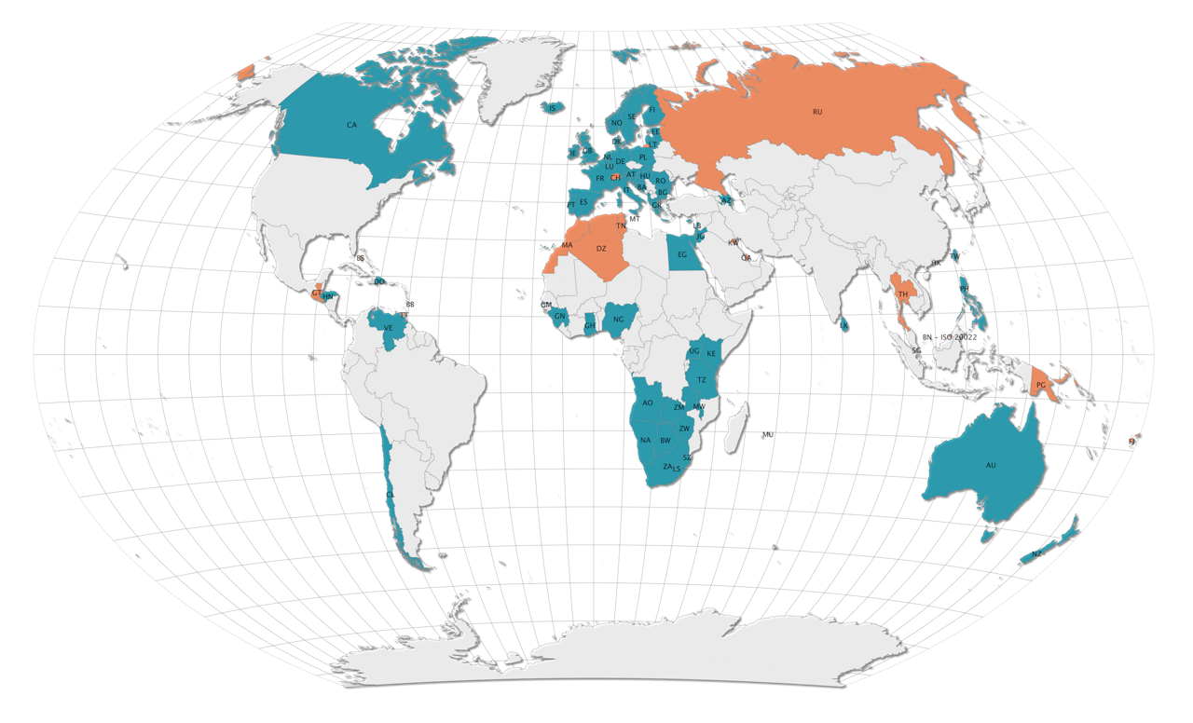
SWIFT for High Value Payment Systems High Value Payments Systems – SWIFT deployment map
Y-Copy
V-Shape

Slide 16
SWIFT for High Value Payment Systems High Value Payments Systems – SWIFT global reach

Slide 17
Background
The new reality of retail payments has an impact on banks
Competition from agile new entrants
New business propositions and improved customer experience,
not hindered by existing legacy
High growth of mobile and Internet technology
Ability to do business on-line,
anywhere, anytime
Threat from cybercrime
Threat is significant and growing - banks are having to strengthen their security provisions
Retail Payments
Impact of increased regulation
Consumer protection
Financial inclusion
Transparency
Financial crime compliance
Credit card interchange fee caps
Regional harmonization
Emergence of new technologies
New technologies, such as block-chain / distributed ledgers, will facilitate the implementation of new payment systems
High customer expectations
Set by m- and e-commerce - must be simple, immediate, certain with cost transparency

Slide 18
RT-RPS Characteristics Key features to be supported by an instant payment system
Instantaneous
Irrevocability
24 x 7
Certainty
24x7: payments can be sent and received all times of the day, every day of the year
Instantaneous*: good funds must be available on the beneficiary’s account in, typically, less than a minute
Irrevocability: once payments are processed, they can’t be recalled
Certainty: payments sent to a beneficiary bank are individually explicitly confirmed (to both payer and payee) or rejected
*The term “Instantaneous Payments” is increasingly used to refer to retail real-time payments

Slide 19
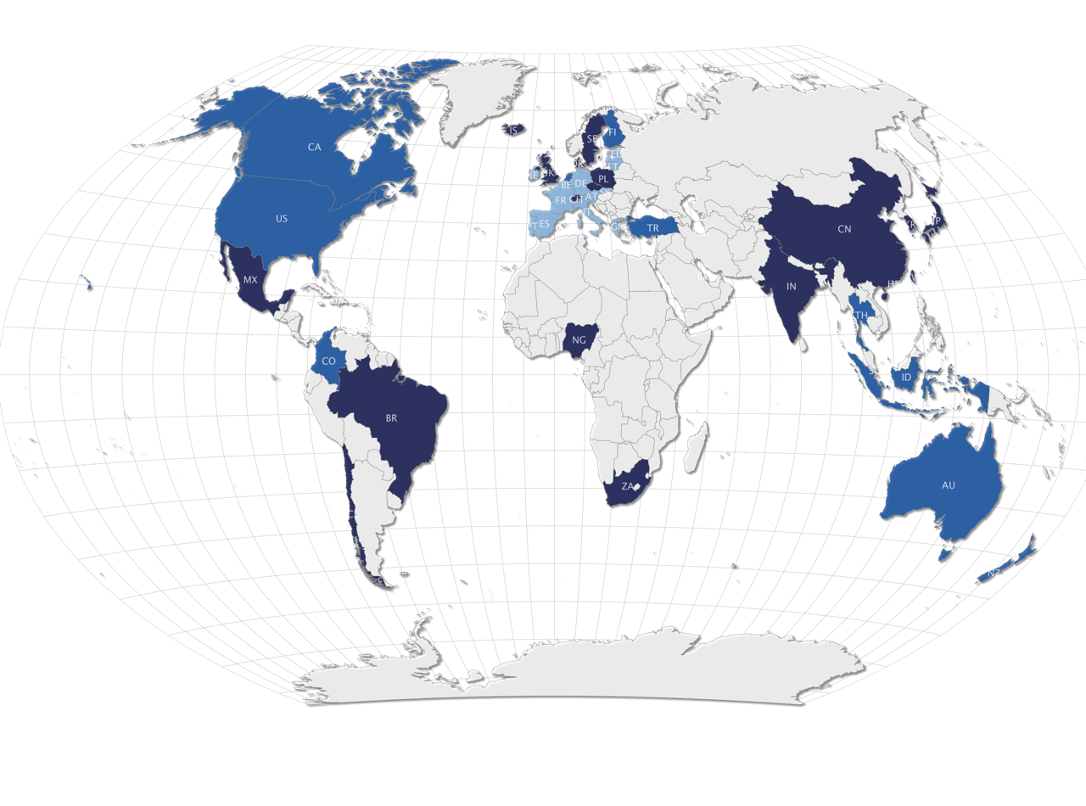
Instant Payments Systems, live in 18 markets, with many more being planned
Live
18 countries ‘live’
Planning
12 countries ‘exploring’ / ‘planning’ / ‘building’
Eurozone
17 additional Eurozone countries ‘exploring’

Slide 20
Clearing happens directly between debtor and creditor banks
Successful clearing triggers immediate settlement in RBA’s central settlement engine
Case Study - New Payments Platform Australia How it works
Overlay Services
24h
$
Addressing
Database
SWIFT
Payment
Gateway
2
Clearing
SWIFT
Payment
Gateway
1
Bank
Channels
Bank
Channels
4
Settlement
3
Settlement
Payee / Beneficiary Customer
SWIFT Payment Gateway
Ordering Customer
Bank
Beneficiary Customer Bank
Fast Settlement Service
Central Bank
RTGS

Slide 22
Pavel Prokudin
pavel.prokudin@swift.com

